Slide 1
Webinar, 09/10/2024
MSCA Staff Exchanges
Aleksandra SCHOETZ-SOBCZAK
European Research Executive Agency
@REA_research, @MSCActions

Slide 2
Overview
1. Policy background
2. Staff Exchanges
3. Application process

Slide 3
1. Policy background

Slide 4
The MSCA under Horizon Europe
Pillar I
Excellent Science
Pillar II
Global Challenges & European Industrial Competitiveness
Pillar III
Innovative Europe
European Research Council
Health
Culture, Creativity & Inclusive Society
Civil Security for Society
Digital, Industry & Space
Climate, Energy & Mobility
Food, Bioeconomy, Natural Resources, Agriculture & Environment
European Innovation Council
Clusters
European Innovation Ecosystems
Marie Skłodowska-Curie Actions
Research Infrastructures
Joint Research Center
European Institute of Innovation & Technology
Widening Participation and Strengthening the European Research Area
Widening participation & spreading excellence
Reforming & enhancing the European R&I system
Notes:
Horizon Europe is the EU’s key funding programme for research and innovation. Following the Multiannual Financial Framework Midterm Review (MTR) decision, the indicative funding amount for Horizon Europe for the period 2021-2027 is EUR 93.5 billion.
More info under:
https://research-and-innovation.ec.europa.eu/funding/funding-opportunities/funding-programmes-and-open-calls/horizon-europe_en

Slide 5
Marie Skłodowska-Curie Actions (MSCA)
Doctoral Networks
Postdoctoral Fellowships
COFUND
MSCA and Citizens
Staff Exchanges
Notes:
As you can see in the slide, and very briefly, there are 5 main MSCAs: There is a continuity and stability in the actions as compared to the previous H2020 framework programme.
Doctoral networks (focused on early researchers) – which target doctoral programmes supporting research in academia and other sectors.
Postdoctoral Fellowship (experience researchers) – supporting the careers of individual researchers and promoting excellence.
Staff Exchanges: promoting knowledge collaboration between organisations and sharing practices in the context of a research project by researchers' mobility.
COFUND: supports regional, national and international doctoral and postdoctoral programmes through co-funding.
MSCA and Citizens: Brings science closer to the public with the European Researchers’ Night.
Regarding the Staff Exchanges action, the budget allocated for the upcoming Call is 99.47 million Euros. In the last 2023 call, the success rate for this action was approximately 30%. In contrast, for other MSC actions like postdoctoral fellowships and doctoral networks, the success rate was approximately 13%.

Slide 6
MSCA: Key policies
Researchers’ training, skills & career development
(all career stages)
Attractive working & employment conditions
Structuring impact on organisations through excellent programmes
Excellent research in all domains (bottom-up approach)
International,
cross-sectoral & interdisciplinary mobility
Strong collaboration with industry & SMEs

Slide 7
2. Staff Exchanges

Slide 8
What is Staff Exchanges?
Research & Innovation mobility action
It equips researchers and organisations worldwide with advanced skills and cross-cutting knowledge
It fosters mobility within entities from both: academic and private sectors
Can be combined with other programmes (synergy)
The budget allocated in 2024 call is € 99,47 M
Notes:
What is Staff Exchanges:
Staff Exchanges is Research & Innovation mobility action
that equips researchers and organisations worldwide with advanced skills and cutting knowledge
and it fosters mobility of entities from both: academic and private sectors
It can be combined with other programmes (synergy)
The budget allocated in 2024 call is € 99,47 M

Slide 9
Added value
Transferable skills & competences
International exposure
Employability & career prospects
Networking & communication
Ideas converted into products, processes & services
Staff members
Transfer of knowledge
Collaborative networks
R&I capacity
Organisations
Notes:
In terms of added value, both staff members as well as their respective organisations benefit from the mobility that is at the core of the action, in terms of networking and collaborations, transfer of knowledge and converting ideas into products, processes and services.

Slide 10
Key features
BOTTOM UP
with different scientific panels
TOP UP ALLOWANCE
5010 €:
2710 € - staff allowance
2300 € - organisation
SECONDMENTS
1-12 months per staff
Interdisciplinary
Intersectoral
International
DURATION
4 years
360 person-months per project
Notes:
Key features:
Bottom up approach with proposals evaluated in different scientific panels.
Top up allowance with unit cost. Secondment budget is raised to 5010€.
Simplification: minimum duration of the secondments 1 month independently of the institution where they go.
Duration of a project is 4 years (48M) with 360 PMs max.

Slide 11
Who can participate
Consortium of min. 3 legal entities in
3 different countries, 2 of which in a different EU Member State or HE Associated Country
Academic sector
If all organisations from the same sector, there must be at least 1 organisation from a non-associated Third Country*
Non-academic sector
* Secondments within EU MS or HE AC must be between different sectors (between academic and non-academic), except for interdisciplinary secondments, which must be limited to a maximum of 1/3 of the total implemented months.
Notes:
Who can participate
Applications must be submitted by a consortium of at least 3 independent legal entities in 3 different countries, 2 of which in a different European Union Member States (EU MS) or Horizon Europe Associated Countries (HE AC).
Only legal entities that are established in EU MS or HE AC can be beneficiaries.
If all organisations are from the same sector (i.e. only academic or non-academic), there must be at least 1 organisation from a non-associated Third Country.
Above this minimum, the participation of organisations from any country is possible.
Secondments within EU MS or HE AC must be between different sectors (between academic and non-academic), except for interdisciplinary secondments, which must be limited to a maximum of one third of the total months spent under the action.
Obviously, secondments must always be between different countries.

Slide 12
Eligible staff
Any type of staff involved in R&I activities (researchers, administrative staff, managerial staff, technical staff)
Each staff member is seconded for a period of
1 to 12 months
(may be split into several stays *)
Researchers at any career stage (from doctoral candidates to postdoctoral researchers)
Staff needs to be devoted full-time to the action during the secondment
Seconded staff
members
Actively engaged in research and/or innovation activities for at least
1 month prior at the sending institution
After the secondment, staff should return to their sending organisation
* With one or several beneficiaries or associated partners.
Notes:
In what concerns eligible staff in general:
Secondments are open to any type of staff contributing to R&I activities. The present Work Programme does not mention Master’s students under the researcher category. A Master’s student may be seconded as technical staff for example.
The definition of staff member is that of the national law and internal practices of the organisation seconding the staff. National rules apply in terms of the link between the sending organisation and the staff member.
Very importantly the staff member must be actively engaged in research and innovation activities for at least 1 month at the sending institution prior to the first secondment
Secondment period: 1-12 months per staff member (can be split). The secondment of a staff member may be split into several stays with one or several beneficiaries or associated partners.
During the secondment, staff needs to be devoted full time to the action
After the period of secondment, seconded staff should return to their sending organisation to maximize the impact of the exchange and ensure transfer of knowledge and long-term collaboration.
Administrative staff directly involved in R&I activities may be seconded under a SE project. It may include, e.g., administrative staff in charge of preparing an application for a patent, administrative staff experienced in data mining and collection, staff dealing with research surveys, and as described in the Description of Action R&I Work Packages.
Purely administrative tasks, e.g., accountants, auditors, secretaries, etc. are not eligible for secondments.

Slide 13
Eligible secondments
EU MS/AC BENEFICIARIES
< 1/3
Guidance/programme-guide_horizon_countries.pdf
Notes:
A summary of the secondments eligible for funding
We fund all mobility within Europe and Associated countries:
From a beneficiary to another beneficiary and different sector
From a beneficiary to another beneficiary and same sector but up to 1/3 all eligible secondments for funding

Slide 14
Eligible secondments
TC PARTNERS
EU MS/AC BENEFICIARIES
Low medium Income TC
High Income TC
Notes:
Although secondments from a country not listed in the annex A of the WP is not eligible for funding, it should be described in the plan for secondments.
Secondments between Third Country (TC) partners are not relevant for the scheme.
A summary of the secondments eligible for funding
From a beneficiary to partner in a TC (sector is not relevant)
From an eligible partner to Europe
List of Participating Countries in Horizon Europe including Third Countries:
https://ec.europa.eu/info/funding-tenders/opportunities/docs/2021-2027/common/guidance/list-3rd-country-participation_horizon-euratom_en.pdf

Slide 15
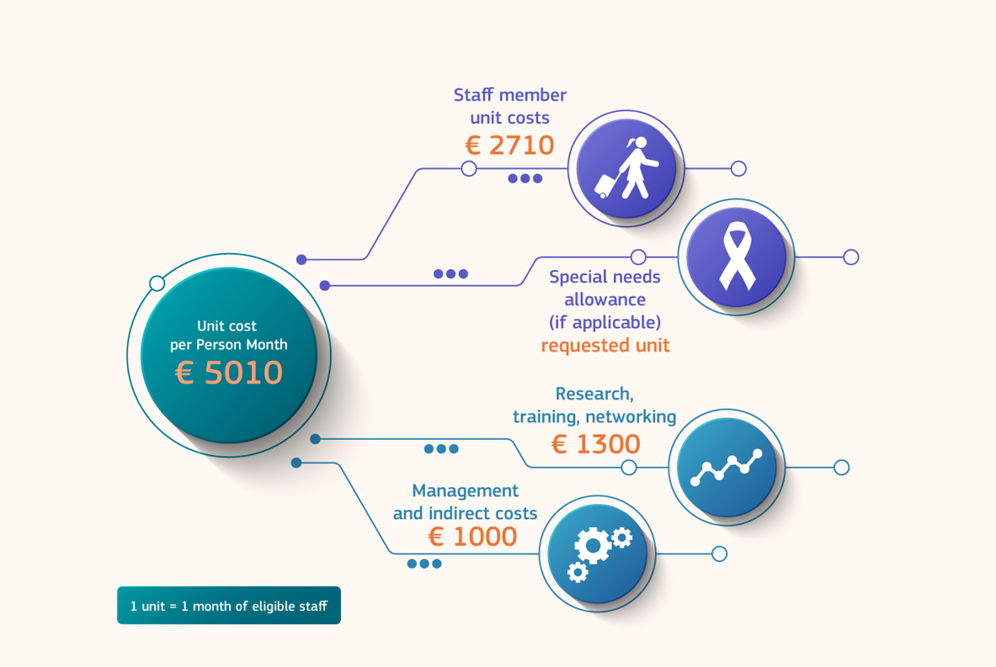
What does Staff Exchanges fund?
CATEGORY A
(Staff)
+ 410 euros (as from 2024 Call)
CATEGORY B
(Institutional)
Budget of SE project based on the Nr of planned secondments
Notes:
What does staff exchanges fund?
Staff exchanges reimbursement is based on unit costs triggered by secondments. The total is 5010 Eur per person month (Unit Cost).
The staff member unit costs amounting to 2710 Euros are to be paid in their entirety as a top-up of their salary and are meant to cover expenses related to the secondment travel, accommodation and subsistence costs.
Institutional costs amounting to 2300 euros can be further divided into research related unit costs and purely managerial costs. The consortium can use some flexibility but only for the use of the category B unit costs. Category B can be used to complement category A top-up allowances.
One thing to keep in mind is that the consortium can agree to transfer funds to organisations seconding staff based in third countries (associated partners) listed by the Commission as low and middle income countries. The details concerning such transfers should be described and ironed out in the consortium agreement.
The above financial arrangements are purely internal and each beneficiary remains bound to report under its own financial statements (Annex 4 to the grant agreement) the unit costs calculated according to the actual duration of secondments of its own staff seconded to other participants plus the secondments of staff from third country partners to its organisation.
The special needs allowance contributes to the additional costs of staff members with disabilities, whose long-term physical, mental, intellectual or sensory impairments are certified by a competent national authority and of such nature that their participation in the action may not be possible without the acquisition of special needs items or services. These special needs items or services shall not have been funded from another source (e.g. social security or health insurance). The special needs allowance should be requested when the need arises.
Part of the amount may be transferred to third country partners in line with the Consortium Agreement, but each beneficiary (as grant recipient), is responsible for the technical and financial implementation of the action.

Slide 16
How to find partners?
Networking events (conferences, workshops, etc.)
Former or current collaborations
Joint projects
Funding and Tender Opportunities Portal
National Contact Point
MSCA matchmaking platform
European Enterprise Network

Slide 17
3. Application process

Slide 18
Key Dates & Budget Call 2024
Call Opening 2024: 19 September 2024
Call Closure: 5 February 2025
Call 2024 Budget: € 99.47 M
SE Info Session: 15 November 2024

Slide 19
HORIZON-MSCA-2024-SE-01 – Indicative timeline
19 Sep. 2024
Launch of the call for proposals
5 Feb. 2025
Deadline for submitting proposals
July 2025
Notification of call results to applicants (TBC)
Nov. 2025
Grant agreement signature for successful projects (TBC)
Nov. 2025
First EU-funded projects start (TBC)

Slide 20
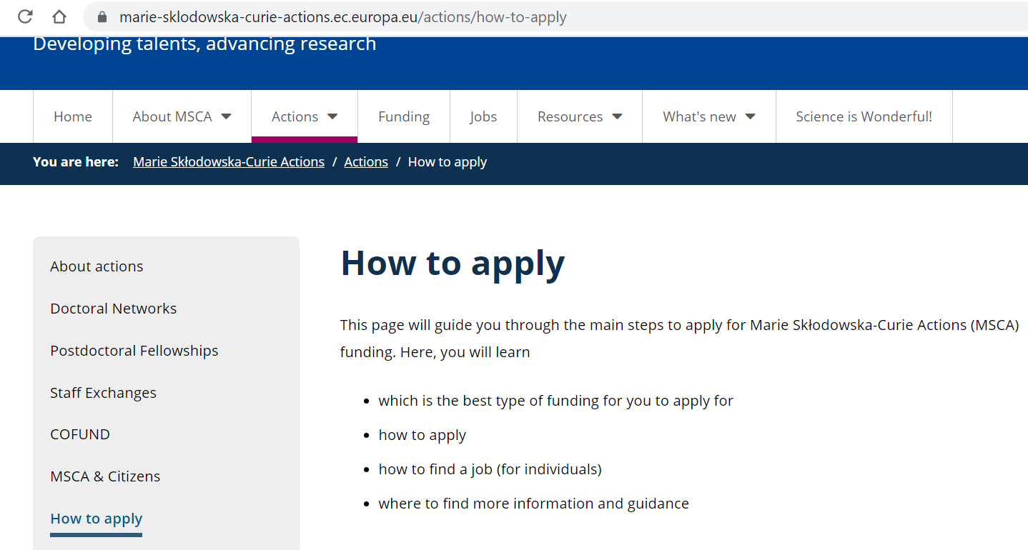
MSCA actions on Europa - REA Website
Notes:
You may find all details about MSCA actions and the Staff Exchanges one on the page published on the Europa – REA website (link in the slide).

Slide 21
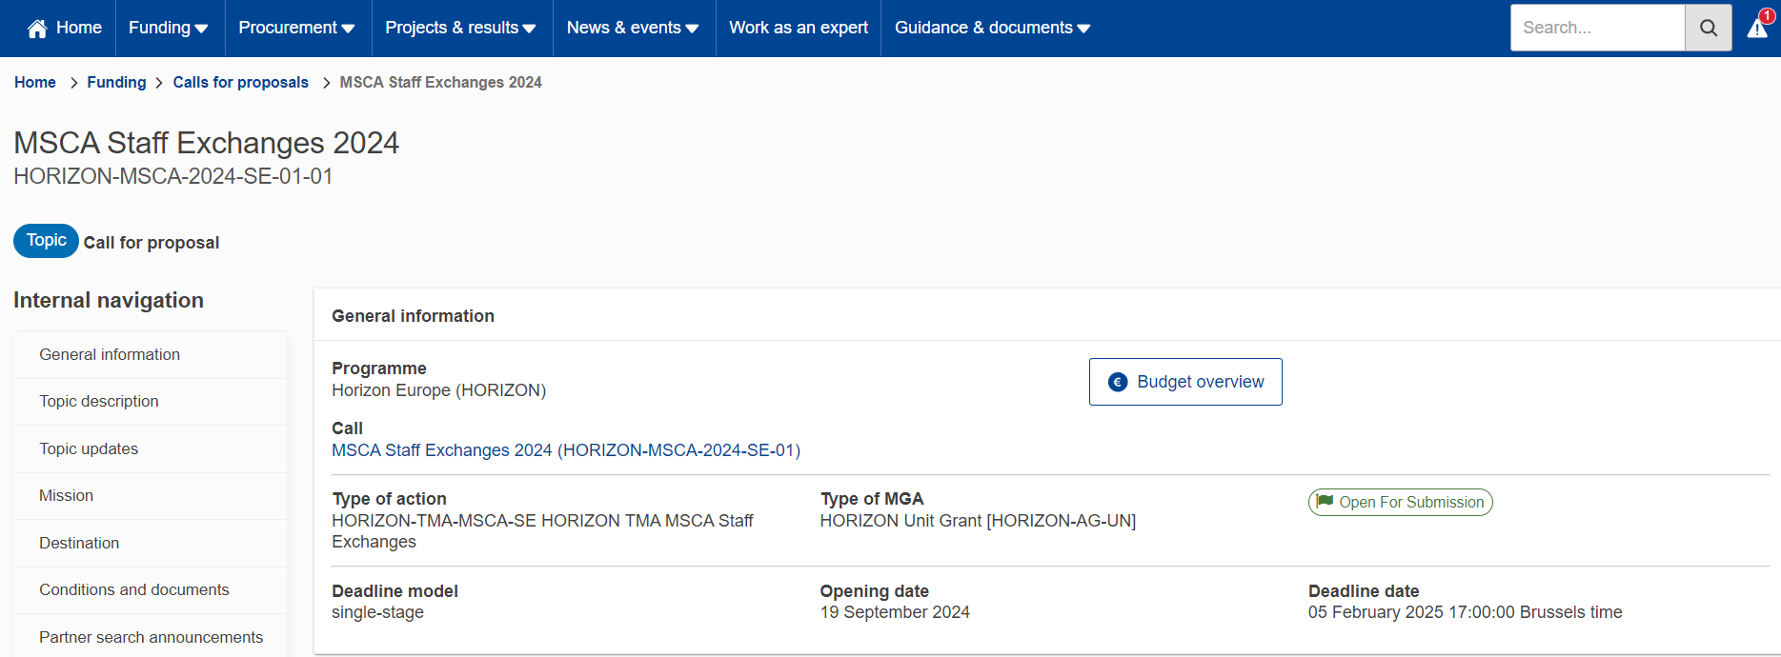
Staff Exchanges 2024 – EU Funding & Tenders Portal
Notes:
For preparing the proposal you may have to go the https://ec.europa.eu/info/funding-tenders/opportunities/portal/screen/home and search your call of interest. By typing MSCA Staff Exchanges, you will be able to find the call 2024.

Slide 22
Starting an application

Slide 23
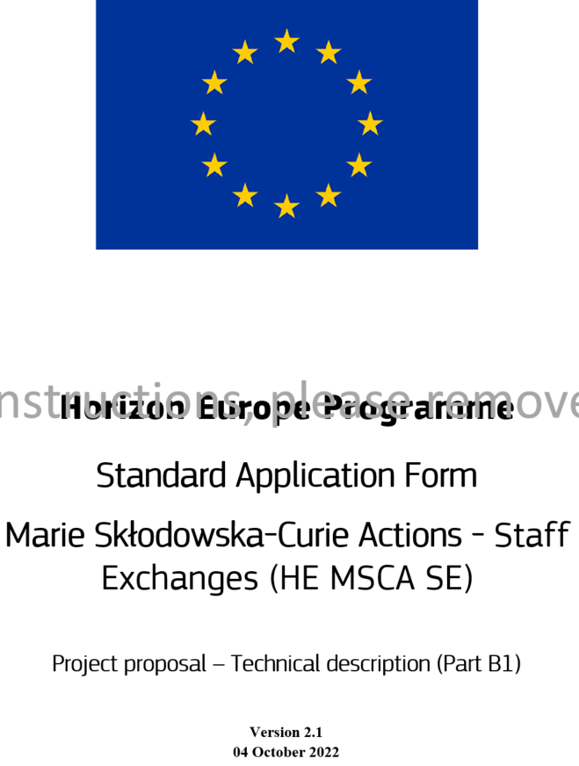
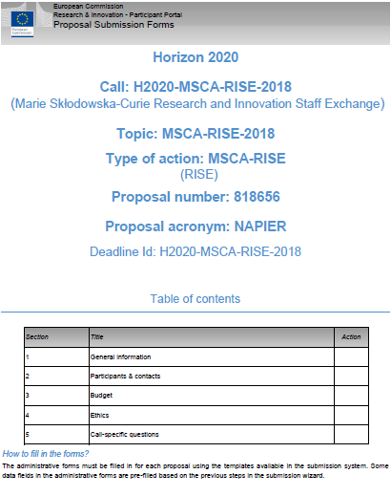
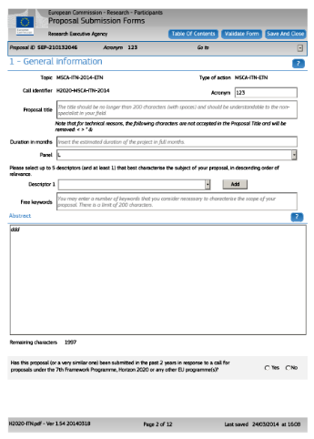
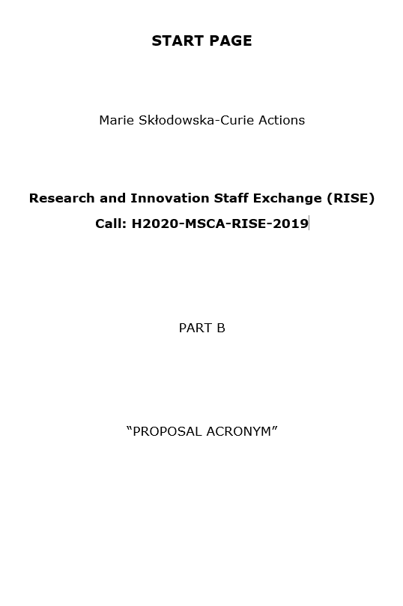
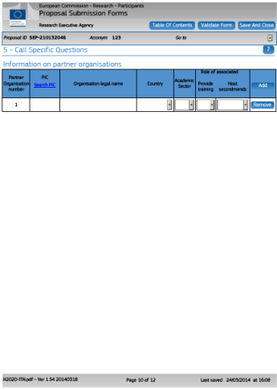
Proposal documents
Part A (structured data)
Part B1 and B2
(description of action)
(to be filled online ) contains administrative information about the
applicant organisations
(to be downloaded from the Portal) contains the technical description
of the project
Notes:
The proposal is composed of two parts:
Part A: contains the administrative part and the budget of the proposal.
Part B: contains the technical/scientific description of the action.

Slide 24
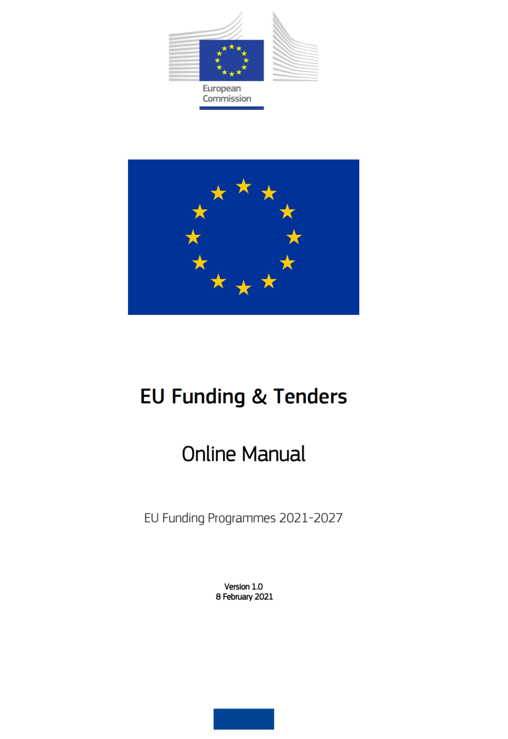
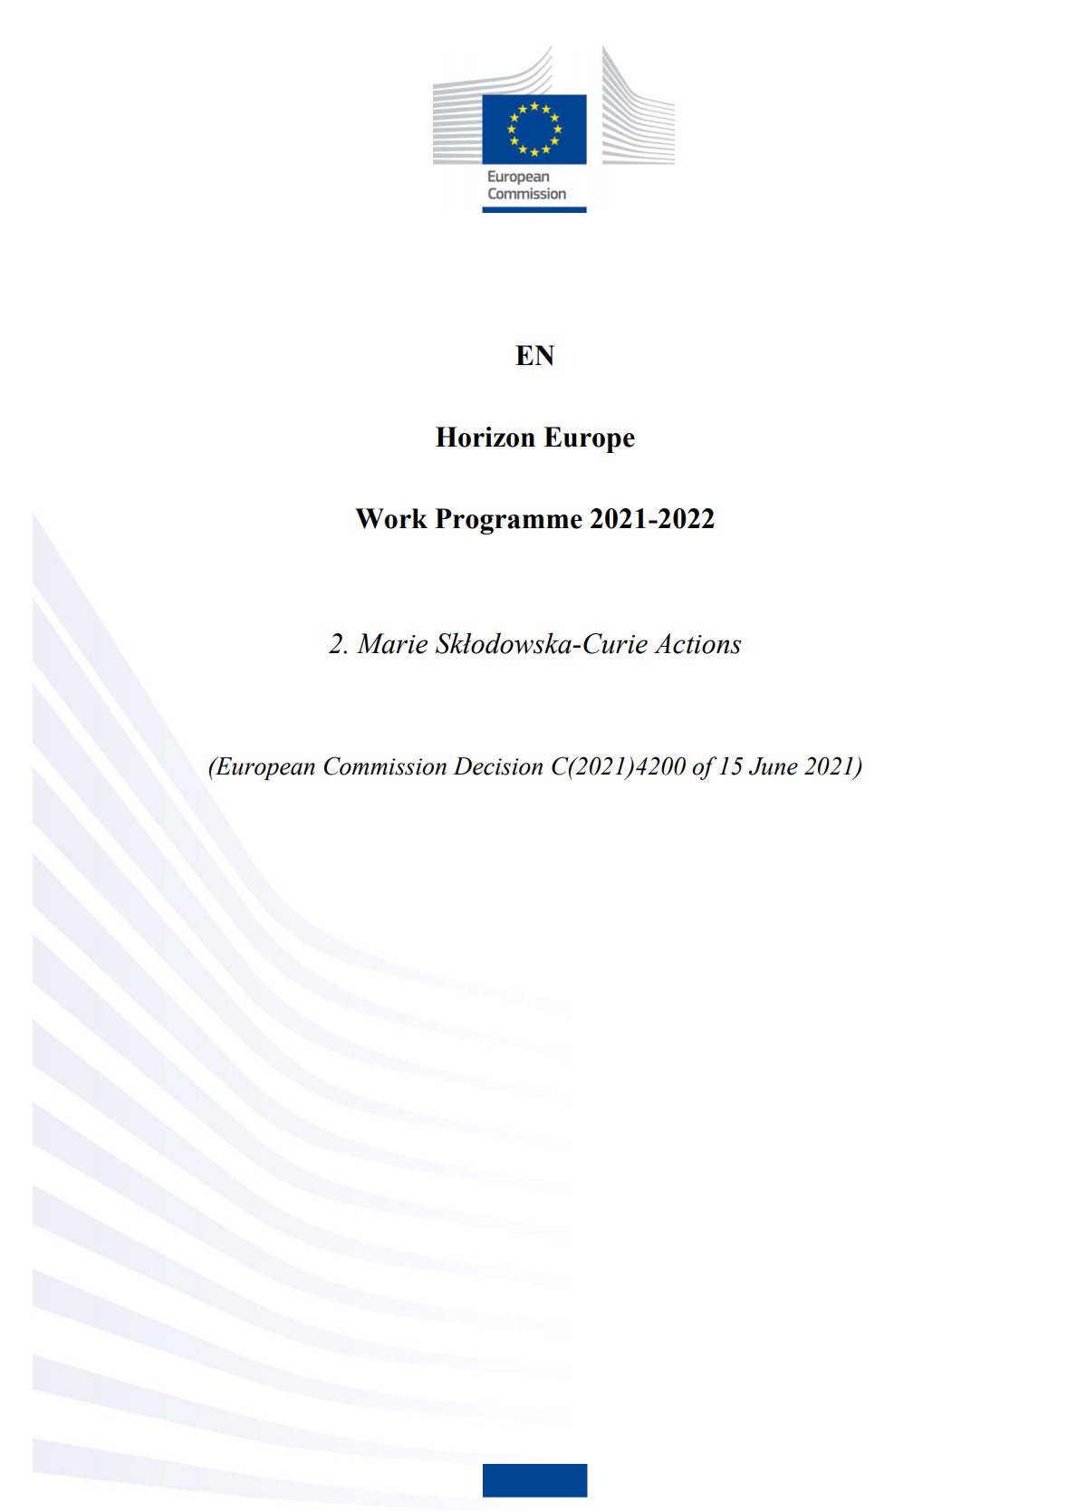
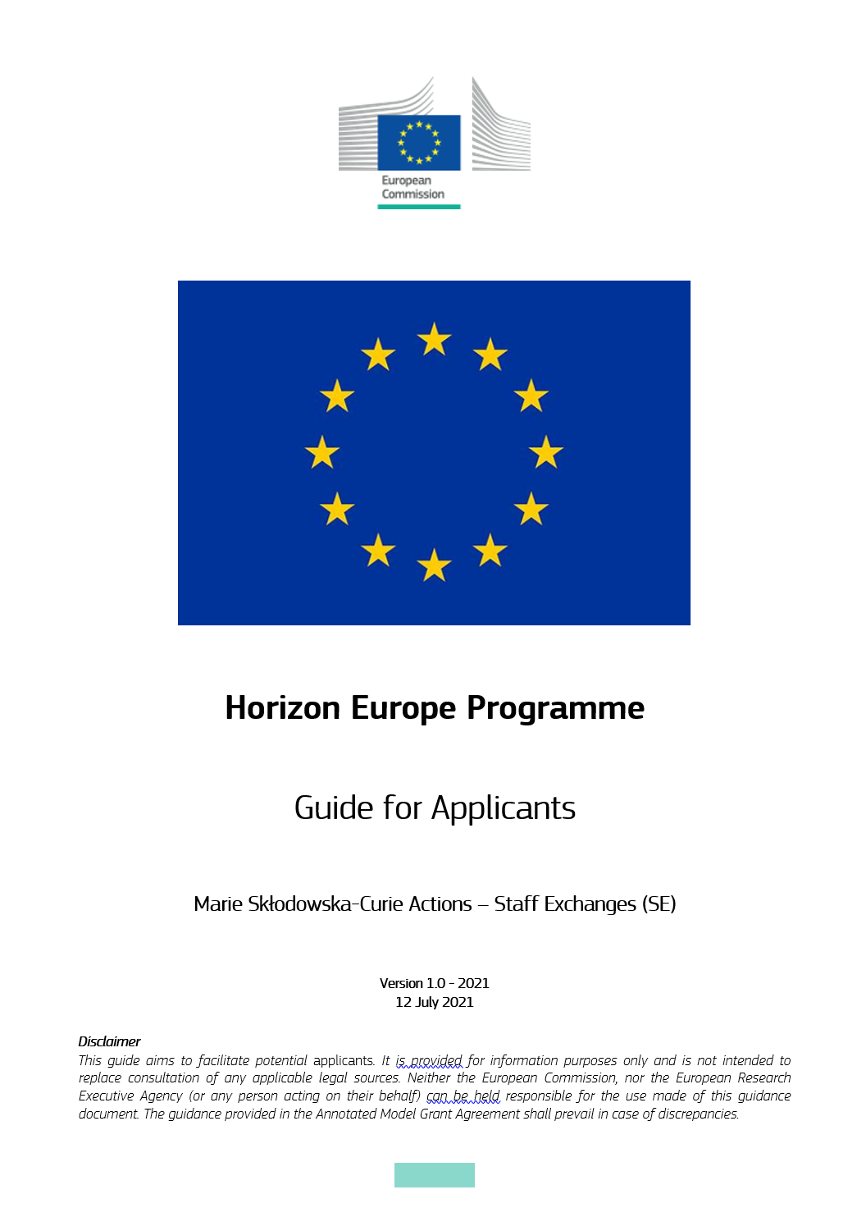
Reference Documents
MSCA Work Programme & annexes
Guide for Applicants
Proposal templates
Model Grant Agreement
Frequently Asked Questions
Online manual on how to submit an application
Notes:
The key documents to read before starting the preparation of a proposal are:
MSCA Work Programme
Guide for Applicants
Proposal Template
Frequently Asked Questions
Model Grant Agreement

Slide 25
Tips and tricks
Get familiar with how funding works
Make sure your organisation can apply and your staff is eligible to take part
Find the best partners to prepare your proposal
Start drafting your application
Check your application with your peers
Submit your application
Notes:
6 steps to prepare your application
Get familiar with how funding works
Make sure your organisation can apply and your staff is eligible to take part
Find the best partners to prepare your proposal
Start drafting your application
Check your application with your peers
Submit your application

Slide 26
Thank you!
European Research Executive Agency
#MSCA #HorizonEU
@REA_research @MSCActions
Horizon Europe Marie Skłodowska-Curie Actions

