Slide 1
Hiring International Student Graduates
Jennifer Cleary, Head of International, IUA
21st September 2023

Slide 3
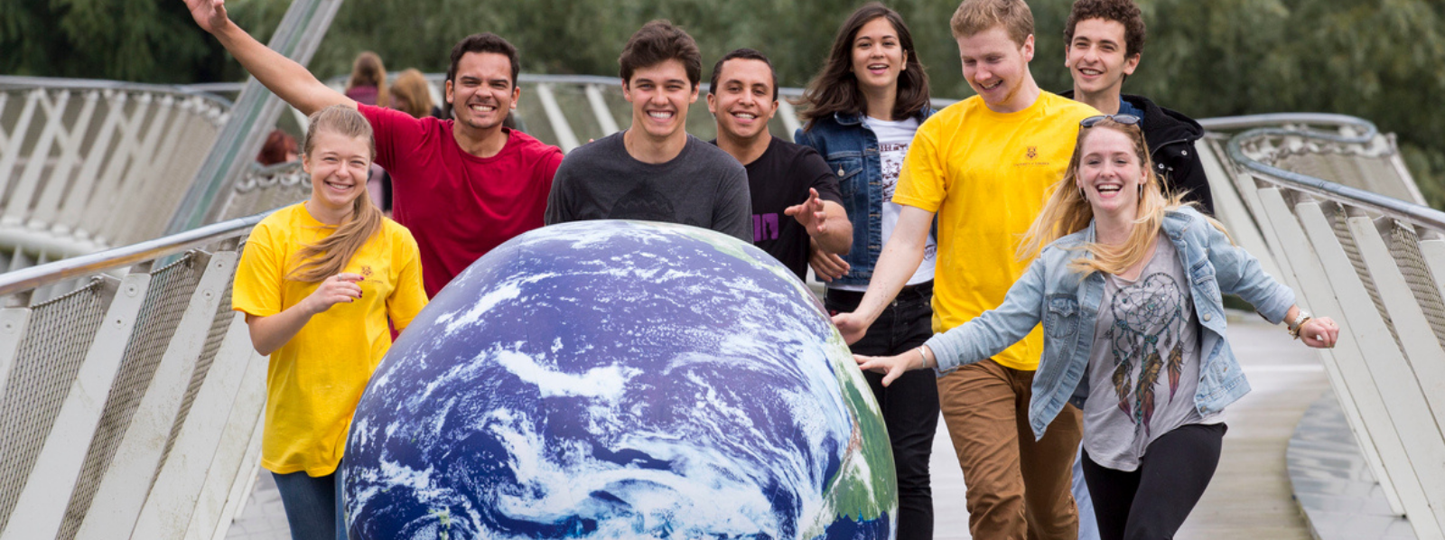
Why Ireland?
I
High quality of education
IUA HEIs consistently ranked in the top 1% of institutions in the world
[16,8047 out of 22,0278 international students 21/22]
Work experience & post study opportunities
USA, China, India, Malaysia

Slide 4
Why hire International Students?
I
Retention and loyalty
Experienced Hire (3 – 5 years approx.)
Greater diversity, cross cultural and global perspectives in workplace
Expanded pool of talent
Bring Graduate working permission ( 1 or 2 years)
High rates of performance – increase long term sponsorship

Slide 5
Student Visa
Graduate Visa Scheme
General Work Permit
Critical Skills
Hosting Agreement

Slide 6
Useful Links
International students working while studying in higher education in Ireland - Education in Ireland
Third level graduate programme - Immigration Service Delivery (irishimmigration.ie)
General Employment Permit - DETE (enterprise.gov.ie)
Fast Track Work Permit for Non-EU R&D (Hosting Agreement Scheme) | EURAXESS
Employable You - An online guide for International Students | Irish Universities Association (iua.ie)
For Employers | Irish Universities Association (iua.ie)
International Students | Irish Universities Association (iua.ie)

Slide 7
Thank you!
Jennifer Cleary, Head of International and IUA HR Manager
Jennifer.Cleary@iua.ie

