Slide 1
MSCA Workshop
Orla Muldoon
Professor of Psychology,
University of Limerick
@orlamuldoon

Slide 2
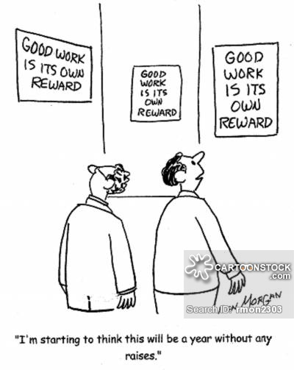
Notes to Self
Only supervise in your key area if interest
It is a lot of work

Slide 3
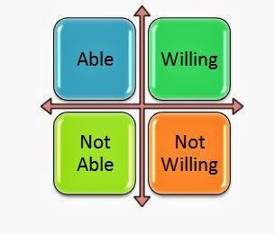
A Winning Application
The Right Candidate
Expertise
Track record
Shared Interests
Clear contributions

Slide 4
Find a Shared Vision
Get your hands on a successful application in a closely related area.
Start lay abstract or outline: get the candidate to complete it and use it as a basis of a meeting.
Then review each section of the form in turn as it arrives.
Use CV and environment to highlight value of the match.
Make clear what you, the applicant and the host elsewhere if appropriate will gain from the match.
Trust your own judgment: beware of generic advise.
You are the scientific expert and mentor- you and the applicant need to be responsive to each others comments for the scientific proposal to develop and be fundable.

Slide 5
orla.muldoon@ul.ie

