Slide 1
MSCA Postdoctoral Fellowships: the Applicant Perspective
Dr. Emma M. Smith
MSCA Actions Fellow
Maynooth University

Slide 2
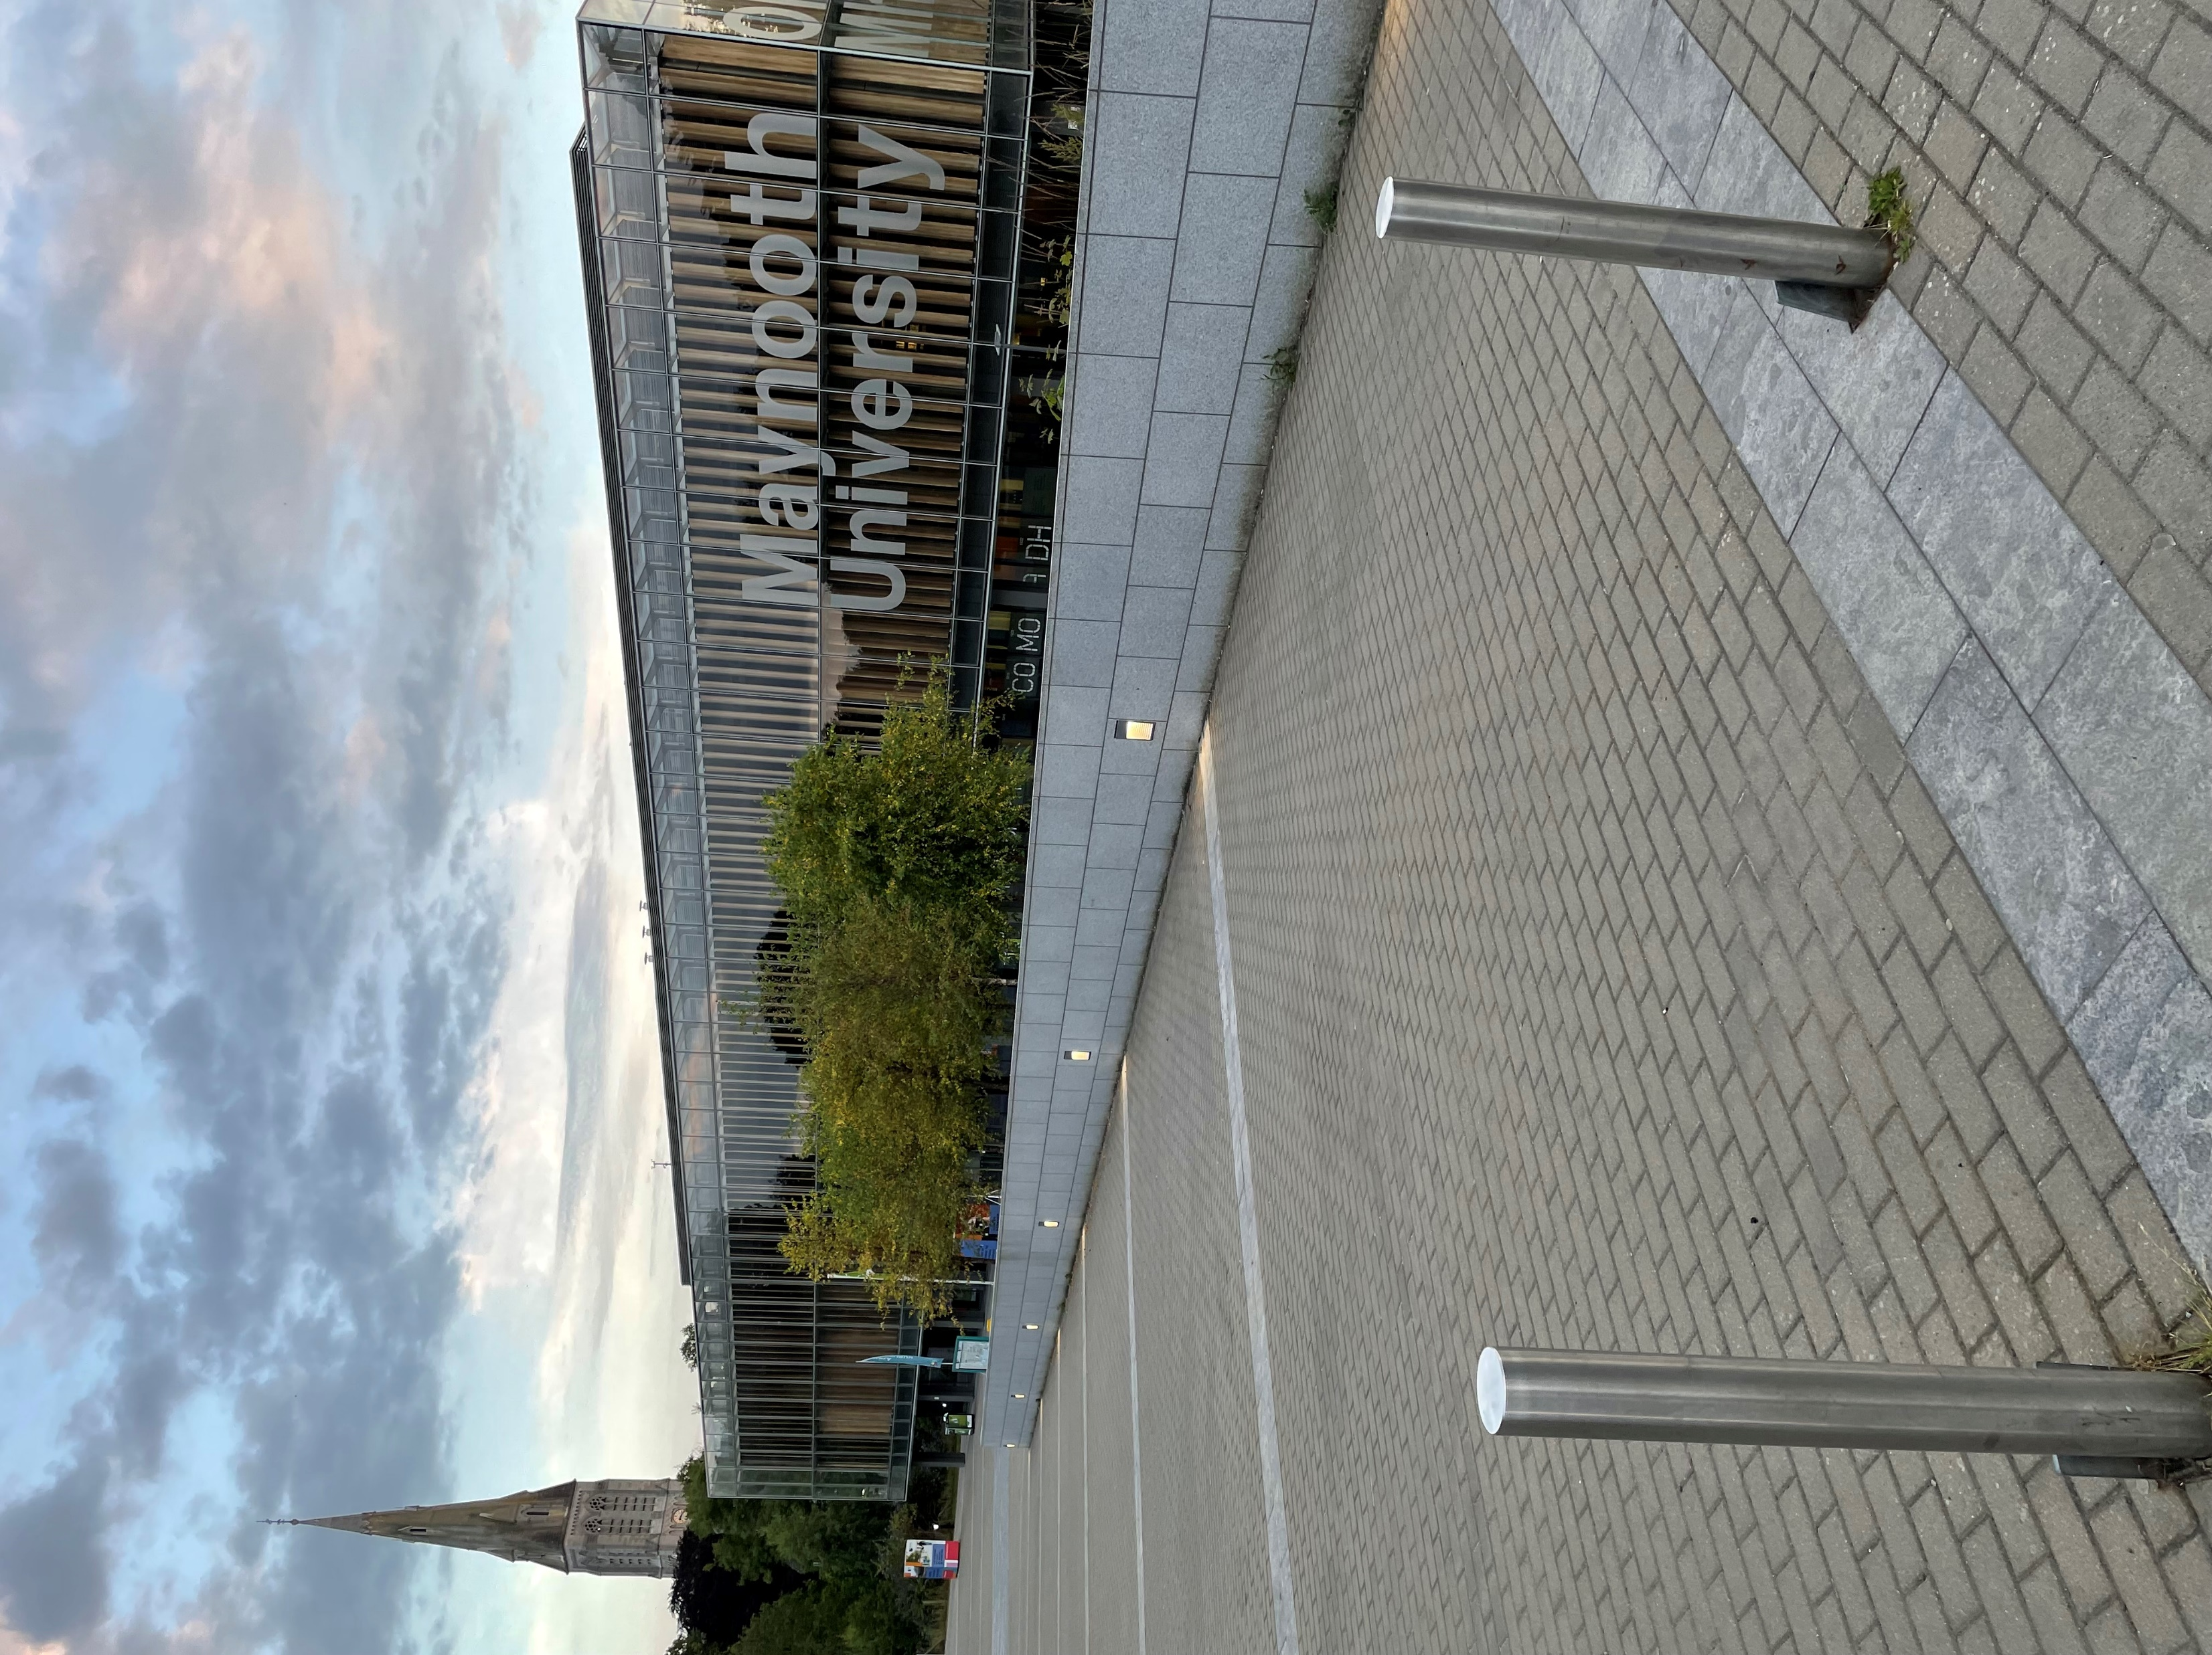
A bit about me

Slide 3
My MSCA Journey
First MSCA Application (2018)
Score: 80
Second MSCA Application (2020)
Score: 98.8
Completed PhD
Started Postdoc
Better CV
Detailed Project
Better Application!

Slide 4
Courses and Workshops (MU, EDF, Others),
Self-Directed Learning, Communities of Practice
Training
WP1: Scoping Review
Desk Research
WP2: Delphi Survey
Participatory Research
WP3: Piloting and Refinement
Development of framework
Expert policy review and focus groups
Document policy good practices
Build consensus on key concepts
Next steps?
Implementation?
Website, Social Media, Academic Publications, Policy Briefs,
Non-Academic Publications and Reports, Visuals, Presentations
Dissemination

Slide 5
Skills Development
EU Accessibility Act
Budget Mgmt
Community Engagement
Scoping Reviews
Delphi Surveys
Transferable Skills
Engaging with UN Agencies
Project Mgmt
Focus Groups
Research Skills
Data Mgmt
Accessible meetings
Policy Brief Writing
Scientific Writing
Lay Audience Comms
Participatory Research
Knowledge Translation
Ethics and Integrity
Grant Writing

Slide 6
Benefits of an MSCA Award
Dedicated time to gain skills and conduct research
Research aligned with your specific interests
Funding for training, conferences, resources
Network of MSCA award holders and alumni (MCAA)
Increased competitiveness for future grant competitions/jobs

Slide 7
The Application Process… Tips and Tricks
Start early, revise often, submit early
Choose the right supervisor and institution –research topic, methodology, resources, fit
Seek feedback from supervisor, peers (especially MSCA fellows), university grants office
Consider project feasibility carefully – Goldilocks approach
Be specific about your objectives and your plans for the Fellowship
Be truthful, but not shy about your accomplishments
Be clear, thorough, and detailed
Every word matters. Never say anything twice if you can avoid it
Use tables to maximize space – ensure your tables match your text
Your plan MUST be cohesive – it must tell a clear story, and make sense together
Strongly consider a secondment/short visits, choose the right host, build a relationship
Don’t ignore the B2 forms!

Slide 8
Consider…
Whatever you write is the ONLY thing the reviewers know about you & your research
Most reviewers are not subject specific experts – make no assumptions
You must convince them
The research is necessary
The methods make sense and are feasible
You are the right person to do it
You will have the necessary supports or obtain training
You must clearly demonstrate that the fellowship will provide opportunities for learning and enhance your career prospects
You must clearly demonstrate that you will contribute to the academic and broader community

Slide 9
Weaknesses…
Clear definitions of concepts are insufficiently well developed. The state of the art provided is very generic and not sound enough.
It is not clear how the proposed methodology is appropriate and effectively could contribute to generating new knowledge based on this research. The proposal lacks a clear identification of the difference between the indicators expected as results.
The transfer of knowledge from the researcher to the host institution is not sufficiently explained. It is unclear in what forms and in which amount the researcher would transfer their knowledge. It is also made insufficiently clear who would benefit from this transfer.
The plan of how the researcher would enhance their career perspective is very general and insufficiently detailed.
The description of the measures to enhance the researcher’s skills covers an insufficient spectrum of the potential necessary skills.
The work plan is insufficiently well justified with many deliverables and milestones for each work package, some of which are planned to be delivered in the same month, making it unclear whether the efforts assigned are appropriate.
The research project as such is not very novel.
The transfer of knowledge from the host to the researcher is almost exclusively through the supervisor, and 'training through research' or using services such as the library. The same goes for the transfer of knowledge from the researcher to the host.
The website is not mentioned as a deliverable or planned in the Gantt chart
No sufficient explanation is provided on the timing of the research, especially on time allocated to prepare the foundation of the project. No sufficient information is provided in the work plan on training related activities.
A lot depends on one specific supervisor, as most of the new skills and knowledge would have to be learned from the supervisor. Meeting twice a month does not seem to be enough to be able to do that, raising doubts on the feasibility of the project.

Slide 10
Strengths
The state-of-the-art is very well explained and the research gap addressed by the project is very well argued. The objectives are very well described in the proposal, they are specific and credible.
The approach and research methods are very well outlined and credible. Methodology is of high quality, with clear and transparent steps, following the relevant framework, and including relevant key users, which will enable co-creation. Sample size is transparently reported, and it is appropriate for this type of study.
Transfer of knowledge plan is of high quality; focused on knowledge and skills, and particularly transferable skills that can be used within and outside academia. Methods of knowledge transfer are highly relevant for each proposed skill that will be required for the proposed research.
It is convincingly described that the researcher has relevant knowledge and experience, and a very good academic background, to transfer some of that knowledge to the host, together with the network of relevant collaborators.
The supervisor is highly qualified, experienced and with a commendable academic track record of a highly productive scientist.
Integration is properly addressed and very credible. Quality of the hosting arrangements is very high.
The researcher’s track record convincingly indicates that the researcher has high potential for the professional maturity/independence. This is evidenced by the relevant postdoctoral fellowship, relevant awards, very good track record in publications for the career stage, high number of conference presentations, excellent track record in obtaining funding. In the majority of publications, the researcher is the first author. In the next phase of the career, the researcher needs the transition to become the principal investigator, and this fellowship has high potential to help in achieving it.

Slide 11
Strengths
It is convincingly demonstrated that the proposal can enhance career prospects of the researcher, as the international experience will enable them to acquire new knowledge and skills, engage with relevant collaborators and expand the network, and further enhance the researcher’s chances for an independent career in academic and non-academic settings. The career will benefit from the secondment beyond the research skills acquired.
Strategy for dissemination of the project results is very well outlined. Multiple relevant and appropriate measures for disseminating the proposal results are suggested, including dissemination to relevant experts (including various methods such as publications, conference presentations, website, policy briefs, etc), non-governmental organizations and other stakeholders.
Strategy for communication of project activities is very well outlined with target audiences, activities, timing and metrics. The quality of the proposed measures is high. Communication activities are multiple and relevant, including various adequate communication channels, and clearly described relevant target audiences. It is particularly commendable that infographics and videos will be created, as this has high potential to engage with end-users.
The work plan is coherent, feasible, exhaustive and in line with the proposed objectives. The Gantt chart gives clear information on workpackages, tasks and deliverables and their timing. Tasks, milestones and deliverables are in line with the proposed objectives, and appropriate.
Monitoring and management structures are appropriate. It is convincingly indicated that the hosting institution has very good experience in this respect, and will provide adequate support.

Slide 12
Final thoughts…
Your score is a reflection of what you wrote and how well you convinced the reviewers – not a reflection of who you are, and how successful you will be.

Slide 13
Thank You and Good Luck!

