Slide 1
MSCA Postdoctoral Fellowships
A Brief Guide
Dr Christopher Reynolds
European Research Executive Agency (REA)
28 March 2023
DISCLAIMER: This presentation is provided for information purposes only and is not intended to replace consultation of any applicable legal sources. Neither the European Commission nor the European Research Executive Agency (or any person acting on their behalf) can be held responsible for the use made of the guidance provided in this document.

Slide 2
Objectives
Short introduction to MSCA and Postdoctoral Fellowships (PF)
Explain the main objectives and eligibility criteria applicable to the PF 2023 call
Talk through what is required of applicants (incl. evaluation criteria)
Some data on Irish applications
Respond to your questions

Slide 3
What are the MSCA?
Marie Sklodowska-Curie Actions (or “MSCA”)
EU-level researcher mobility programme established in 1996
Highly competitive and prestigious fellowships
All career stages
More than 120,000 researchers supported

Slide 4
The MSCA under Horizon Europe
Doctoral Networks
Doctoral programmes in and outside academia incl. joint & industrial doctorates
Postdoctoral Fellowships
Support to excellent postdoctoral researchers
Staff Exchanges
Support for research and innovation staff exchanges
COFUND
Co-funding doctoral and postdoctoral programmes
MSCA and Citizens
Public outreach events (Nights)
Total budget 2021-2027: €6.6 billion

Slide 5
MSCA Postdoctoral Fellowships (PF)
Budget (2023): €260,47mn (€221.40mn European, €39.07mn Global)
Call deadline: 13 September 2023
Objective
  “[E]nhance the creative and innovative potential of researchers holding a PhD, wishing to acquire new skills through advanced training, international, interdisciplinary and inter-sectoral mobility.”
Monobeneficiary: One researcher, one host organization (EU/AC)
Two types: European and Global Fellowships
Host organizations in EU or HE Associated Countries
Open to all scientific fields, including Euratom
Open to “excellent researchers of any nationality” (with some restrictions for GF and Euratom )

Slide 6



European vs Global Fellowships
European Fellowships
Global
Fellowships
Outgoing phase: 12–24m
EU MS/AC
EU MS/AC
EU MS/AC
Third Country
Return phase: 12m
Third Country
Duration: 12-24m
+ Non-Academic Placement
Max. 6m
Duration: 24-36m

Slide 7
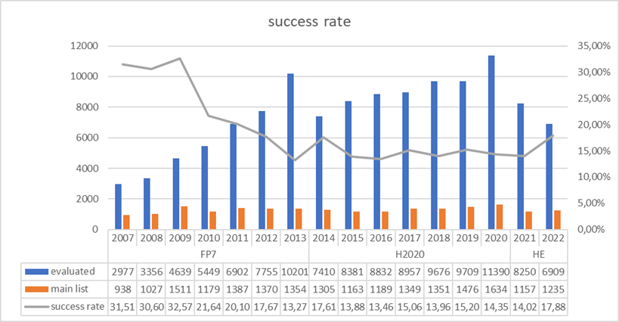
Popular programme

Slide 8
Key points about MSCA-PF
Postdoctoral researchers only [ELIGIBILITY]
Maximum of 8 years FTE postdoctoral research experience [ELIGIBILITY]
Researcher mobility scheme [ELIGIBILITY]
Training through research
12-24m (EF) or 24-36m (GF) + Non-Academic Placement (max. 6m)
Secondments encouraged (worldwide, up to 1/3 of project duration)
Non-Academic Placements possible (up to 6m at end of project)

Slide 9
Eligibility criteria
Postdoctoral researchers only
Must be “in possession of a doctoral degree” before call deadline
If not yet awarded, successful defence before call deadline must be “unconditional”
Max. 8 years of FTE postdoctoral research experience
Measured from date of award of PhD
Time spent outside of research does not count
Researcher mobility
“Must not have resided or carried out their main activity in country of the beneficiary (EF) or the host for the outgoing phase (GF) for more than 12 months in the 36 months immediately before the call deadline”
Must be “Long-term residents” of EU/AC for Global Fellowships

Slide 10
Secondments & Non-Academic Placements
Researcher must be hosted at premises of the beneficiary
But secondments, short visits and non-academic placements also possible
Secondments possible worldwide, up to 1/3 of the project duration (i.e. 8m for a 24m project)
Non-Academic Placement: up to 6m after the end of the project in a non-academic institution
Not a big take-up so far…

Slide 11

Example 1
European Fellowship
Irish researcher awarded a PhD in 2019 in the UK, remains resident there. Applies for a European Fellowship in the field of nanotechnology together with a host institution in Ireland.
ELIGIBLE? Awarded a PhD before the Call deadline; less than 8 years since award of PhD; has not resided in Ireland for more than 12 months in previous 3 years.

Slide 12

Example 2
Global Fellowship
Indian researcher living in Ireland for previous 3 years, PhD in 2022, applies for a Global Fellowship in the field of thermodynamics with a host in France, and outgoing phase in the US.
Eligible? Awarded a PhD before the call deadline; less than 8 years since award of PhD; not more than 12 months in France in previous 3 years…but “long-term resident” in EU/AC?

Slide 13
The MSCA-PF Evaluation
Large-Scale Evaluation
Due to large number of proposals
Standard Peer-Review
≥ 3 experts per proposal
Bottom-up Programme
Proposals and Experts from all disciplines
Expert Balance
of experience, nationality, gender, age, sector, etc.
8 Scientific Panels
CHE, ECO, ENG, ENV, LIF, MAT, PHY, SOC
Single-Stage Evaluation
Call deadline to funding decision: 5 months (+3m to GA signature)

Slide 14




Evaluation Process
Proposal
ALLOCATION OF PROPOSALS TO EXPERTS?
- DESCRIPTORS AND KEYWORDS
Expert 1
Expert 2
Expert 3
Individual Evaluation Report
Individual Evaluation Report
Individual Evaluation Report
Consensus Discussions
Consensus Report / Evaluation Summary Report

Slide 15
Proposal Ranking
Proposals ranked – and funding allocated - by Scientific panel (NB. separate ranking for European and Global Fellowships)
Ex-aqueo cases: priority established in the Work Programme
Seal of Excellence: awarded to proposals which score ≥ 85%
New for PF-2022 Call: Resubmission restriction for proposals with same researcher and same host scoring <70% in previous evaluation
Evaluation Review procedure

Slide 16
Evaluation Criteria
See MSCA Work Programme 2023-2024 (C(2022)7550 of 6 December 2022)

Slide 17
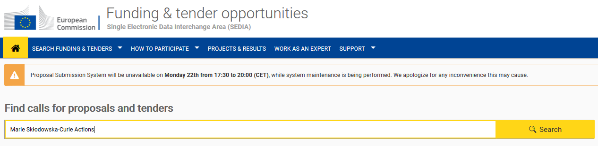
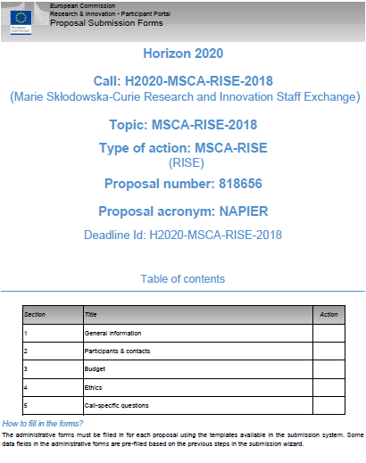
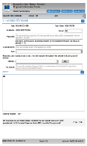

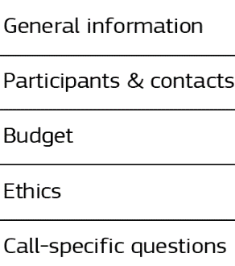
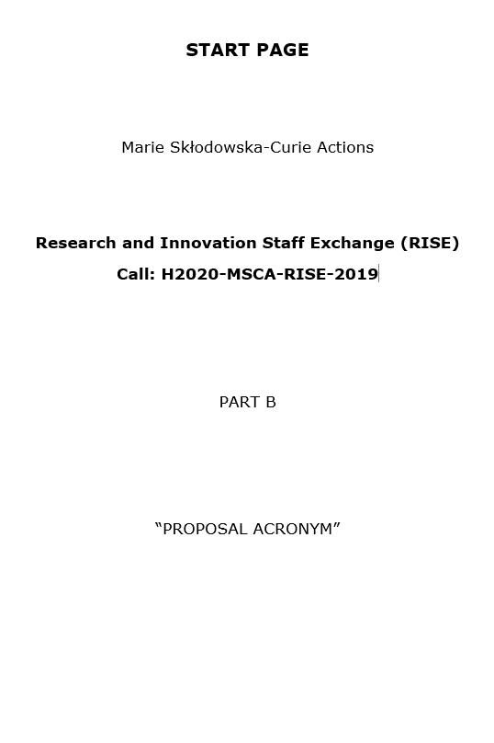

Proposal Submission
Part A
(Application Forms)
Part B
(Technical Description)

Slide 18
Part A (Application Forms)
Structured data entered into the IT system
Acronym and Title for the project (NB title is not the same as acronym)
Select the Scientific Area (i.e. panel) which is the “best fit”
Up to 5 “Descriptors” which best characterise the content of the proposal, in descending order of relevance
First 3 descriptors linked to selected panel, others unrestricted
Free keywords
Abstract: maximum 2,000 characters
Resubmission?

Slide 19
Part A
Researcher Information, including:
PhD award date (or date of successful defence)
If PhD awarded more than 8 years ago, complete table for extensions
Countries of residence for past 5 years
Beneficiary Information, including:
Participant Information Code (PIC)
Outgoing host (for GF)
Non-academic placement host (if applicable)
Indicate if secondment planned, but outline only in Part B

Slide 20
Proposal Part B1
Part B of the Proposal is comprised of two documents (Part B1 and Part B2), uploaded as separate PDF files
Part B1
- Technical description of the scientific work
- Limit of 10 pages (excess pages will not be visible to evaluators)
Minimum font size 11 points, with standard spacing (footnotes, tables, etc: 8 points)
Use the Part B template available on the MSCA-PF Call page and structure your proposal accordingly

Slide 21
Proposal Part B2
Part B2 (no formal page limit)
CV of the Researcher (ca. 5 pages)
Capacity of the Participating Organisations (max 1 page per organisation)
Letter of Commitment (for Global Fellowships)
See Part B template on MSCA-PF call page for more information

Slide 22
Funding levels
MSCA Postdoctoral Fellowships 2023-2024 | Contributions for the recruited researcher Per person-month |  |  |  |  | Institutional unit contributions Per person month
 | Living Allowance | Mobility Allowance | Family Allowance | Long-term leave allowance (if applicable) | Special needs allowance (if applicable) | Research, training and networking contribution | Management and indirect contribution
 | €5,080 | €600 | €660 | €5,680 x % covered by beneficiary | Requested unit x (1/number of months) | €1,000 | €650

Slide 23
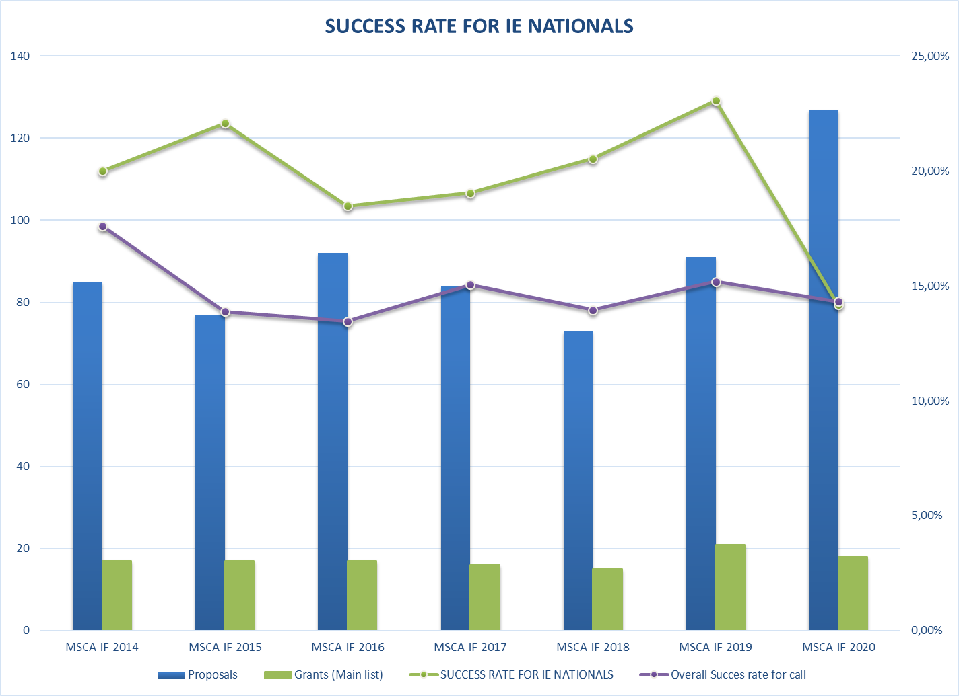
Success rate for Irish researchers

Slide 24
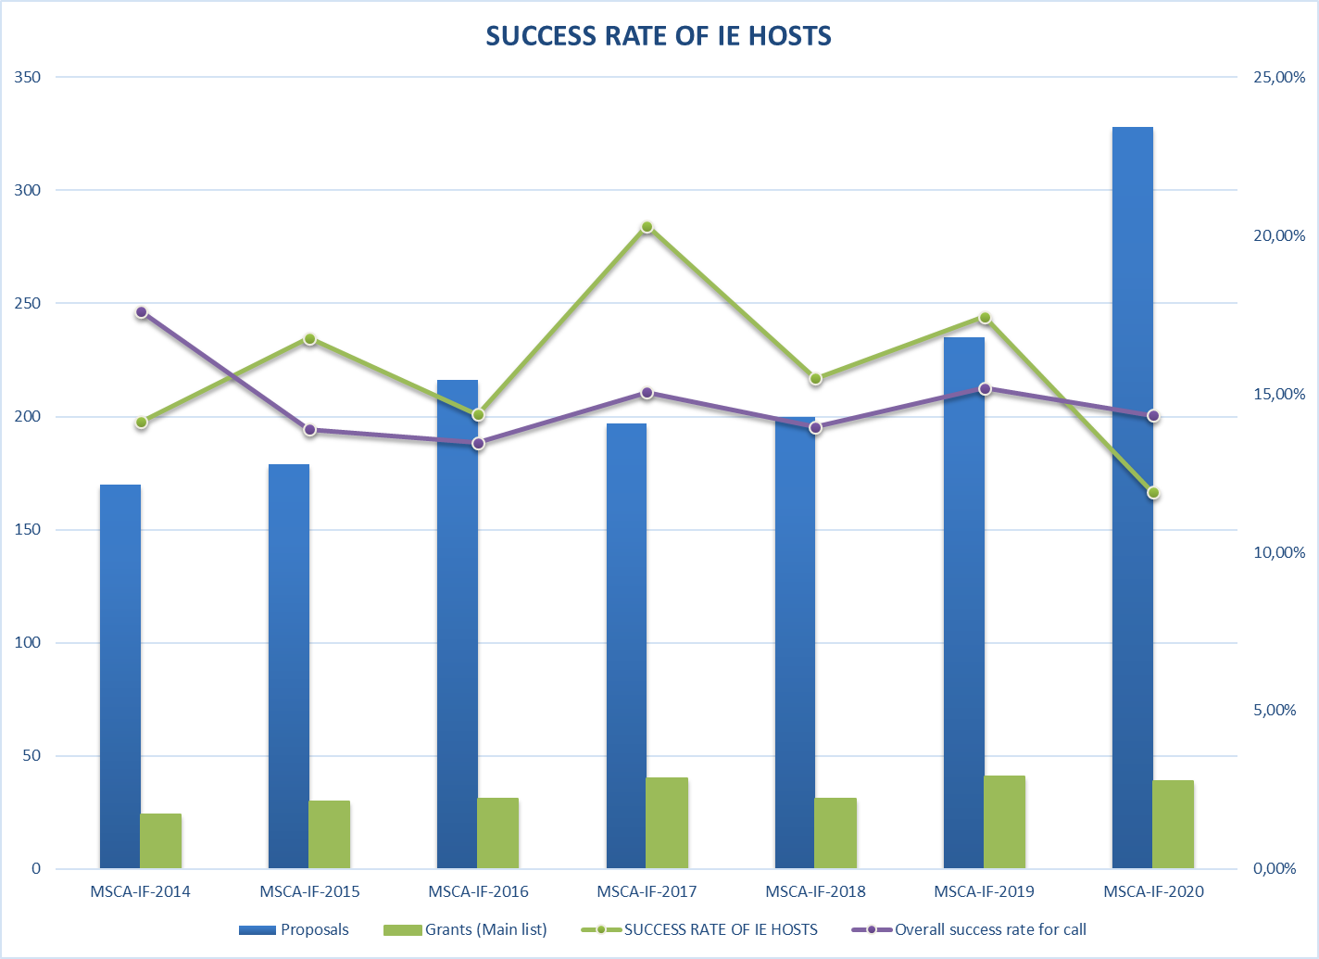
Success rate for Irish institutions

Slide 25
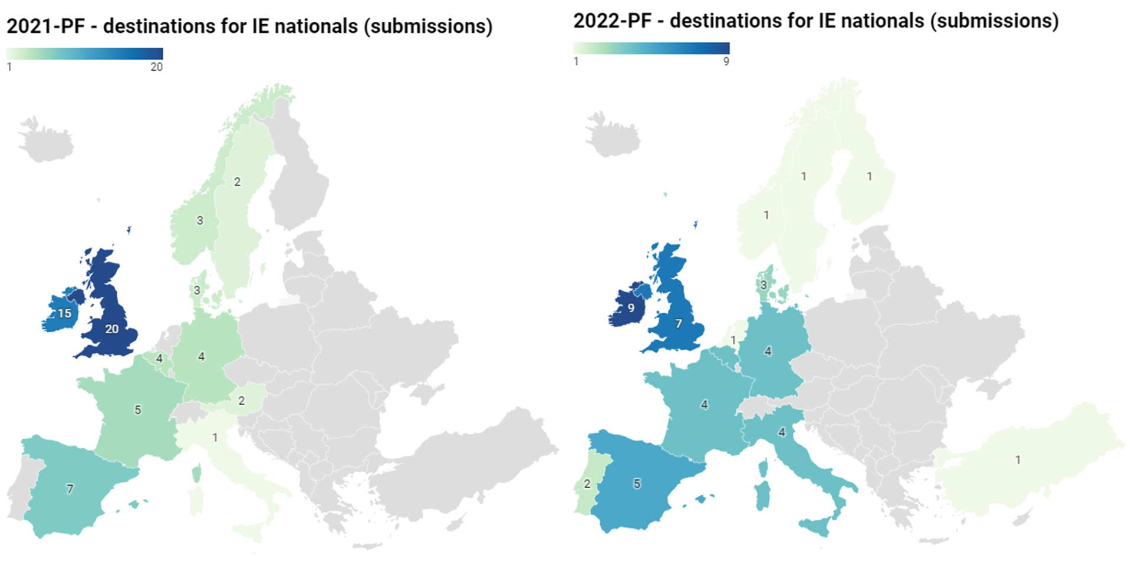
Ireland and MSCA-PF

Slide 26
Common Errors
Missing the Call deadline
Not respecting eligibility requirements (e.g. PhD or max 8 years research experience)
Exceeding the page limits
Missing Letter of Commitment (for Global Fellowships)
Confusing Secondments and Non-Academic Placements
Requesting an ineligible Non-Academic Placement or secondment
Using too small font

Slide 27
Call Planning
Call Opening: 12 April 2023
Call Deadline: 13 Sept 2023
Evaluation period: Oct 2023 – Jan 2024
Launch Grant preparation: Feb 2024
Project Starting dates: Mar/Apr 2024 - Sept 2025

Slide 28
Resources and Guidance
MSCA Work Programme
MSCA-PF Guide for Applicants
Proposal templates
FAQs
Horizon Europe Model Grant Agreement
Horizon Europe Annotated Model Grant Agreement (DRAFT)
MSCA Website
Research Enquiry Service
National Contact Points

Slide 29

Questions?
© European Union 2022
Except where otherwise noted, this presentation is © European Union and is licensed under the CC BY 4.0 license.

