Slide 1
UNIVERSITIES AND SMEs – WAYS TO ENGAGE
Prof Teresa Hogan - Director of the Small Business Charter
Yvonne McLoughlin - Head of Careers Service

Slide 2
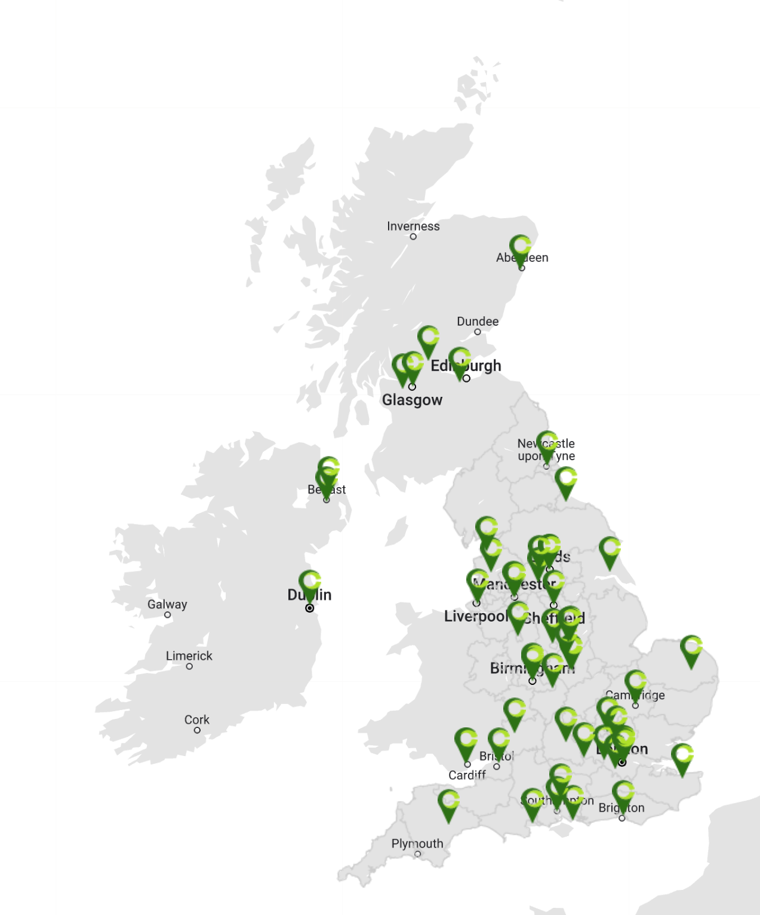
Ireland’s University of Enterprise
First in Ireland to hold Small Business Charter

Slide 3
Ireland’s University of Enterprise
An award for Universities that excel in supporting
small businesses
local economies and
student entrepreneurship

Slide 4
DCU Enterprise Supports
DCU Business School – Centre for Executive and Int Education
Growth Programmes
Family Business Continuity
Thrive
SMEs
Small Business/
Supports
seminars, podcasts,
online articles, annual
conferences, policy briefs, masterclasses…
Innovation Vouchers, Seminars. Master classes Conferences
Enabling knowledge transfer
SME Network
Entrepreneurs
Start-ups
FUSION
Students
Enterprise
Education
DCU Annual Hack4Change
Enactus Academy
Student Accelerator

Slide 5
FOCUS on SME Engagement
Consulting Projects by Students
Sector Specific Initiatives/Projects
Innovation Vouchers
SME Placements – INTRA DCU
SME Careers
Enabling knowledge transfer

Slide 6
DCU SME Engagement Snapshot
Workshops/seminars for SMEs
105 events with 2,928 SME participants
Consulting Projects by Students
160+ student projects with SMEs
Innovation Vouchers by Staff
45 SME Projects – 27 Business School
Enabling knowledge transfer

Slide 7
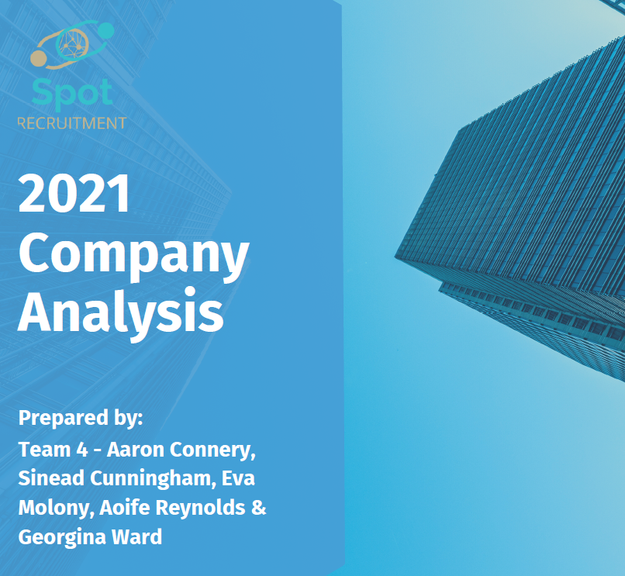
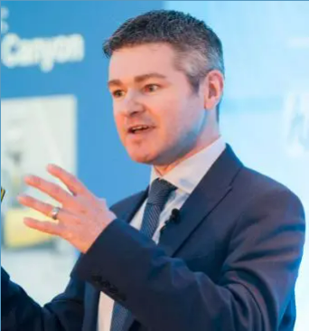
Student Consulting Projects
160+ student projects with SMEs
EXAMPLE : Spot Recruitment
Masters in HRM -
Strategic Analysis of an SME Project
competitive analysis
new sector opportunities
rebranding
David Butler CEO - VALUE ADDED
Prof. Brian Harney, Professor of HRM,
SME Management Skills Steering Group

Slide 8
Sector Specific Courses
Bord Bia MSc in Insights & Innovation (Food)
Sponsored internships in innovative Irish SMEs
Consumer-Led Innovation in a 3rd Generation Family Business
The Role Of Sustainability in a Food SME:
Enabling knowledge transfer

Slide 9
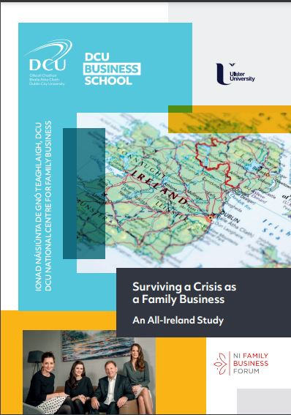
Sector Specific Courses
Family Business Continuity Programme
First executive education programme in Ireland
to examine multigenerational business growth
and development
6 x Covid-19 Infoseries - 1,257 SMEs
Enabling knowledge transfer

Slide 10
Sample Staff Projects
45 Innovation vouchers with SMEs
27 Vouchers from Business School
EXAMPLES
SME Consulting Company – Future of Work
eCommerce infrastructure audit
Digital Towns –digital readiness of rural towns and potential impacts of digitalisation
Enabling knowledge transfer

Slide 11
FOCUS on SME Engagement
Consulting Projects by Students
Sector Specific Projects
Innovation Vouchers
Enabling knowledge transfer
4. SME Placements – INTRA DCU
5. SME Careers

Slide 12
DCU SME Engagement
Hiring DCU Students and Graduates
INTRA Office
For student internships / industrial placements as part of degree programmes
Careers Service
Summer Internships, entry level positions, graduate programmes, experienced hires
Enabling knowledge transfer

Slide 13
DCU SME Engagement
“INTRA” Module – Industrial Placements
- Compulsory/optional accredited module
- 36 undergrad and 4 postgrad degree programmes across 4 faculties
- 1400 students in 2022
27% in SMEs
- Mostly full time paid placements ranging from 2 to 12 months
- We negotiate with employers to ensure vacancies are relevant for areas of study
- Employer issues a fixed term contract of employment
- For unpaid placements, we have a tripartite agreement
- Constantly changing and growing database of employers
Enabling knowledge transfer

Slide 14
DCU SME Engagement
INTRA - Recruitment Process
Speak with industry area coordinator in the INTRA office about your requirements – Maeve Long – maeve.long@dcu.ie
Compile a job description (template available)
Send it to the coordinator
Vacancy is advertised on an internal portal
CVs of candidates are shared with you
You pick interviewees
Set up schedule of online interviews with the INTRA office
Select your intern(s)
First come, first served basis – students get just one offer
Enabling knowledge transfer

Slide 15
DCU SME Engagement
Employer Feedback
The process allowed us to give the student a good opportunity to experience real client work but also helped us deliver actual value for a major client of ours by giving them access to a high performing intern who developed an app they are rolling out to their staff.
Immensely useful. It allows us to assign key deliverables that are not being completed on time due to newer pressures or moving targets. In my space having a resource dedicated to innovation and task completion is a massive benefit to my team.
I personally use the internship as a way to reflect back on how we operate and interact with new young people in the organisation. How we pass on work practices and nurture our own career growth by how well the intern performs and grows during the internship is a valuable measuring tool. Fresh perspectives are a great thing that comes with having an intern join the team.
Enabling knowledge transfer

Slide 16
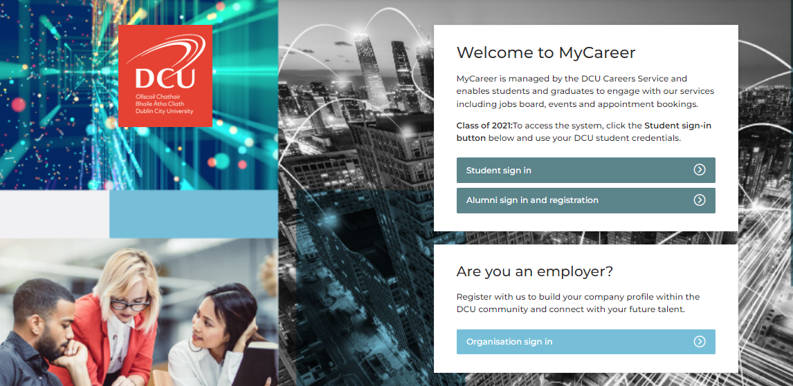
DCU SME Engagement
Careers Service:
How to target students and recent graduates
Jobs Board – mycareer.dcu.ie
Enabling knowledge transfer
Over the period 2019-2021
342 SMEs advertised jobs on the DCU Careers Services job portal

Slide 17
Careers Service
SME Partnership Development
Employer Insights
Mentorship Programme
Events and Skills Sessions
Build Brand Awareness
Enabling knowledge transfer

Slide 18
DCU Contacts:
DCU Website Collaborate with us: https://business.dcu.ie/collaborate-with-us-2/
SME Consulting Projects:
Sula Awad Business School Industry Liaison Officer
sula.awad@dcu.ie
Enabling knowledge transfer

Slide 19
DCU Contacts:
Hiring Students and Graduates
INTRA Internships (Industrial placements as part of degree programmes
intra@dcu.ie
dcu.ie/intra
Summer Internships, Entry Level Positions, Graduate Programmes, Experienced Hires
careers@dcu.ie
Dcu.ie/careers
Enabling knowledge transfer

