Slide 1
Delivering World-Class Skills to Attract Investment
IUA Webinar
23rd May 2022

Slide 2
An agency
with a difference.
Driving Ireland’s competitiveness through talent.
A Government agency, we work in partnership with businesses of all sizes to identify and address their upskilling needs.
Our mission is to help businesses compete globally through industry-led people development.

Slide 3
Our
Approach
For business, by business.
Fundamentally an enterprise-led approach.
We collaborate directly with businesses in each industry sector, helping them define their skill needs. We respond with the frameworks and programmes to meet those needs, bringing together Government, industry and higher education to tailor the most effective response possible.

Slide 4
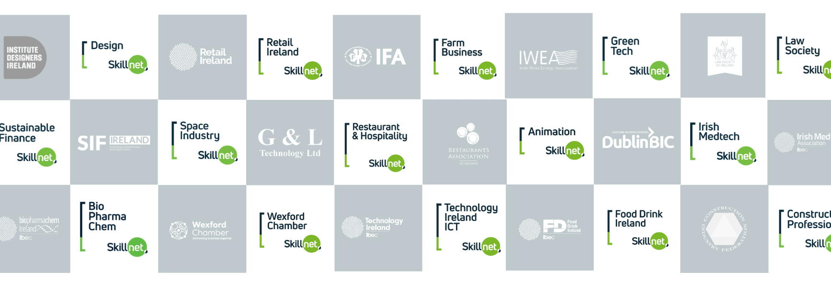
A Partnership with 73 Industry Bodies

Slide 5
Skillnet Ireland Areas of Focus
Digital
Skills
Skills for Climate Action & Sustainable Businesses
Management Skills & Mentoring for SME Sector
Skills
Supply to
FDI Sector
Future Skills, Research & Innovation

Slide 6
Status and Reporting Structure
Minister
Simon Harris TD
Department of Further and Higher Education, Research, Innovation and Science
Skillnet Ireland (Est 1999): Board Composition
Chairperson
Brendan McGinty
Business and Employer Representatives (7)
Employee Representatives (3)
Ministerial Representatives (3)
Skillnet Ireland Organisation (32 Staff)
Strategy & Policy Alignment
Delivery Effectiveness
Funding & Operations
Finance, Governance & Risk
Communications & Marketing
Chief Executive
Paul Healy

Slide 7
Skillnet Ireland
Funding
Exchequer Funding from Ireland’s National Training Fund
Private Sector Co Investment on Programmes
EU Programme Funding
Source | 2022 Amount (€ Million)
National Training Fund | €42
Private Sector Co-Investment | €25
EU Programmes | €11
Total | €78

Slide 8
Skillnet Ireland Champions all learning that builds talent.
Leadership &
Management
Development
Specialised,
Sector Specific
Upskilling
Mentoring
& Coaching
Academic
Co-Creation &
Research
Continuing
Professional
Development
Networking
& Informal
Learning

Slide 9
Skillnet Ireland Future Skills Programme
Purpose: To initiate, fund and develop industry /higher education collaborations:
Focused on future skills.
Where gaps are identified in current provision.
Enterprise led-approach: Needs/gaps identified by companies in the first instance. Collated by the Skillnet and proposed to Skillnet Ireland for development funding .
Engagement with HEIs, partnering with the Skillnet Network (& its member companies) to develop new programmes.
Developed programmes then delivered on a cost-sharing basis between Skillnet and companies
Ireland's first post-grad in AI, Blockchain, MEng in Digitalisation of Manufacturing,
FinTech, and many more developed through the Skillnet Ireland Future Skills Programme.

Slide 10
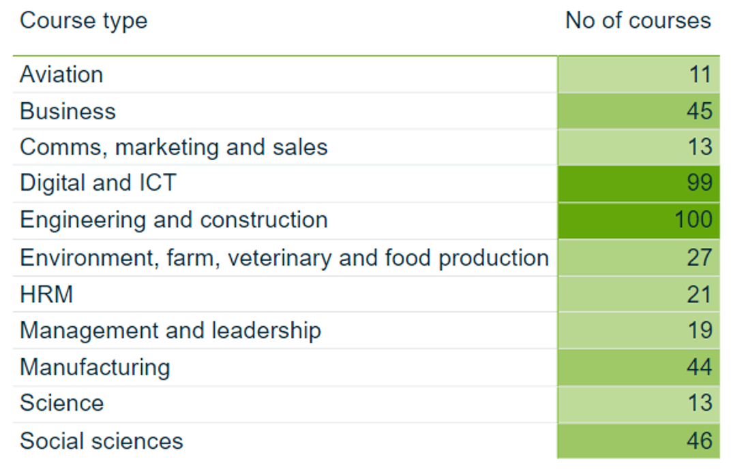
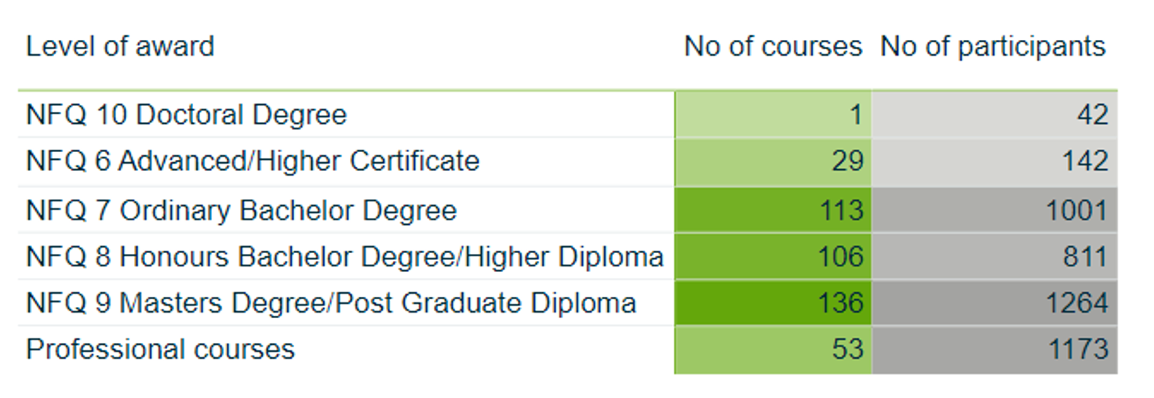
Courses Developed & Delivered with Skillnet & HEIs (2021)
Total: 438
Total: 438 4292

Slide 11
Supporting Implementation of
Government Strategies
Skillnet Ireland, together with our partner organisations , contribute to both the formation and the implementation of enterprise and labour market policy, delivering substantive actions across all key cross government and sectoral strategies.

