Slide 1
MSCA Ireland Postdoctoral Fellowships Webinar
Hugh J. Byrne
26th April 2022

Slide 2
Human Capital and Mobility
HCM (Human Capital and Mobility) is one of the 15 specific R&D programmes implemented by the Commission of the European Communities under the Third Framework Programme 1990-1994.
The central objective of the programme is to increase the quantity and quality of human resources available for research and technological development which will be needed by the Member States in the coming years.
The mission is thus to assist in the creation of a genuine European scientific and technical community through a bottom-up approach focused on the training and mobility of staff and the formation of networks.
RACE (Research & development in Advanced Communications technologies in Europe (1988-1992 ))
ESPRIT II, "Organic Low Dimensional Systems“ (1989- 1993)

Slide 3
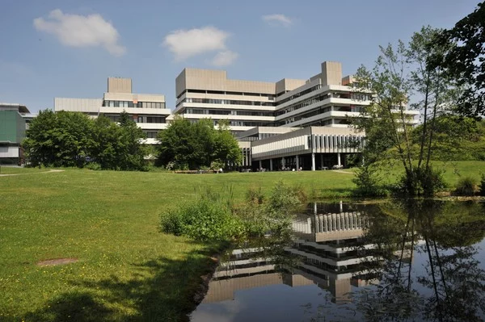
April 1991- July 1995
HCM: Oct 1992- March 1994
1st Proposal as an Independent Researcher

Slide 4
January 1996 – to date
MSCA Individual Scholarships 2003 (Evaluator)
MSCA Research Training Networks 2003 (Evaluator)
MSCA Research Training Networks 2004 & 2005 (Evaluator/Rapporteur)
……
……
……
……
MSCA ITN, February 2016 (Evaluator and Rapporteur)
MSCA ITN, February 2017 (Evaluator)
MSCA ITN, February 2018 (Evaluator)
MSCA, October 2020 (Evaluator/Rapporteur)
MSCA Individual Fellowships, December 2021 (Evaluator)
Get to know the “Inside Line”
Networking
Stimulate your own ideas

Slide 5
January 1996 – to date
FP7, MSCA Co-Fund, (with NBIPI) October 2008 (€107,899)
FP7 MSCA Individual Fellowship Award, “Gold Nanoprisms as Raman Signal Amplifiers for Bioimaging of Lung Cancer”, Furong Tian (2013)
EU H2020 MSCA Individual Fellowship Award, “Advanced Data Mining Procedures Applied to Raman Spectroscopy Investigations of Interactions between Drugs and Cells: Spectro-Metrics”, David Perez-Guaita, (2018)
EU H2020 MSCA Individual Fellowship Award, “RAMan spectroscopy for tracking Exosome based delivery of Nutraceuticals”, Sounderya Nagarajan, (2019)

Slide 6
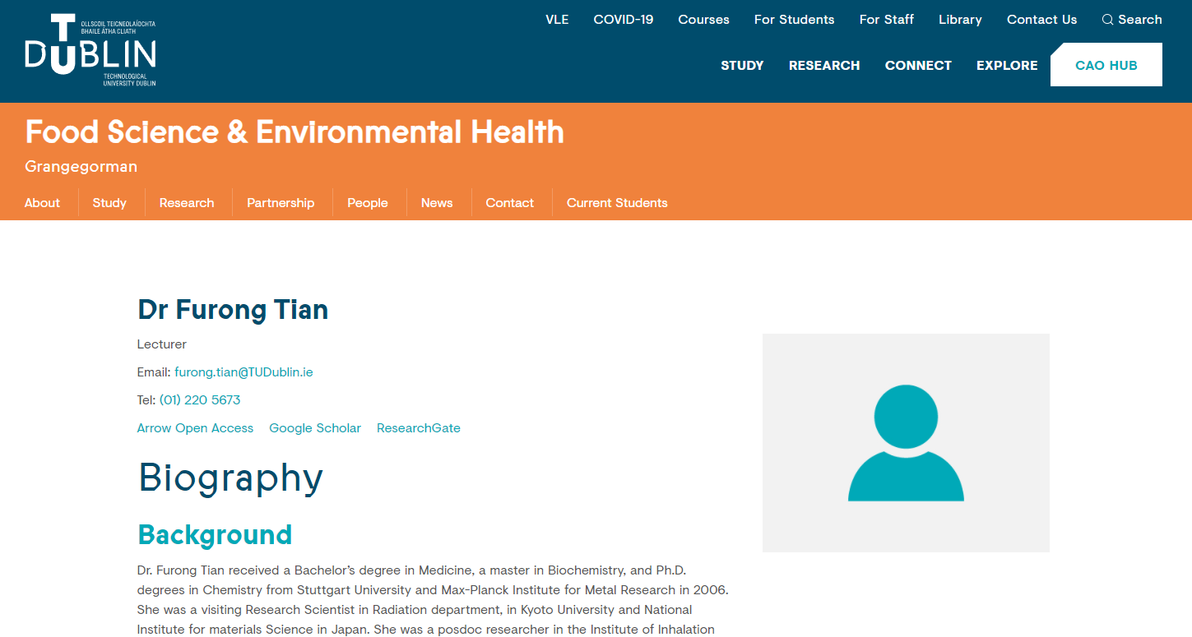
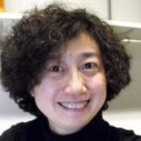

Slide 7
Jointly Supervised PhD:
“Gold nanoparticles in environmental health – novel synthesis and applications”, TU Dublin PhD, Kangze Liu, July 2020
Joint Publications: (10)
“Surface Enhanced Raman Scattering with gold nanoparticles: Effect of particle shape”, Furong Tian, Franck Bonnier, Alan Casey, Anne E. Shanahan, Hugh J. Byrne, Analytical Methods, 6, 9116-9123 (2014)
“Dual Targeted Immunotherapy via In Vivo Delivery of Biohybrid RNAi-Peptide nanoparticles to Tumor-Associated Macrophages and Cancer Cells”, João Conde, Chenchen Bao, Yeqi Tan, Daxiang Cui, Elazer R. Edelman, Helena S. Azevedo, Hugh J. Byrne, Natalie Artzi and Furong Tian, Advanced Functional Materials, 25, 4183-4194 (2015)
“Investigating the role of shape on the biological impact of gold nanoparticles in vitro”, Furong Tian, Martin J.D. Clift, Alan Casey, Pablo del Pino, Beatriz Pelaz, João Conde, Hugh J. Byrne, Barbara Rothen-Rutishauser, Giovani Estrada, Jesús M de la Fuente and Tobias Stoeger, Nanomedicine, 10, 2643-2657 (2015)
“Plasmonic gold nanoparticle for detection of fungi and human cutaneous fungal infections”, Tobiloba Sojinrin, João Conde, Kangze Liu, James Curtin, Hugh J Byrne, Daxiang Cui and Furong Tian, Analytical and Bioanalytical Chemistry, 409, 4647–4658 (2017)
“Cold Atmospheric Plasma Induces ATP-Dependent Endocytosis of Nanoparticles and Synergistic U373MG Cancer Cell Death”, Zhonglei He, Kangze Liu, Eline Manaloto, Alan Casey, George Paul Cribaro, Hugh J. Byrne, Furong Tian, Carlos Barcia, Gillian E. Conway, Patrick J. Cullen and James F. Curtin, Scientific Reports, 8, 5298 (2018)
“Investigating the Role of Gold Nanoparticle Shape and Size in Their Toxicities to Fungi”, Kangze Liu, Zhonglei He, Hugh J. Byrne, James F. Curtin and Furong Tian, International Journal of Environmental Research and Public Health, 15, 998 (2018)
“Combination Strategies for Targeted Delivery of Nanoparticles for Cancer Therapy”, Zhonglei He, Kangze Liu, Hugh J.Byrne, Patrick J. Cullen, Furong Tian, James F.Curtin, in “Applications of Targeted Nano Drugs and Delivery Systems; Nanoscience and Nanotechnology in Drug Delivery”, Shyam S. Mohapatra, Shivendu Ranjan, Nandita Dasgupta, Raghvendra Kumar Mishra, Sabu Thomas eds, Elsevier Inc., p191-219 (2019)
“A novel, rapid, seedless, in situ synthesis method of shape and size controllable gold nanoparticles using phosphates”, Kangze Liu, Zhonglei He, James F. Curtin, Hugh J. Byrne and Furong Tian, Scientific Reports, 9, 7421 (2019)
“Developing gold nanoparticles-conjugated aflatoxin B1 antifungal strips”, Tobiloba Sojinrin, Kangze Liu, Kan Wang, Daxiang Cui, Hugh J Byrne, James Curtin and Furong Tian, International Journal of Molecular Sciences, 20, 6260 (2019)
“Cold Atmospheric Plasma Stimulates Clathrin-Dependent Endocytosis to Repair Oxidised Membrane and Enhance Uptake of Nanomaterial in Glioblastoma Multiforme Cells”, Zhonglei He, Kangze Liu, Laurence Scally, Eline Manaloto, Sebnem Gunes, Sing Wei Ng, Marcus Maher, Brijesh Tiwari, Hugh J Byrne, Paula Bourke, Furong Tian, Patrick J Cullen, and James F Curtin, Scientific Reports, 10, 1-12 (2020)

Slide 9
Jointly Supervised PhD:
“Shedding light on cellular function: Combining kinetic, mechanistic modelling approaches with label free Raman microspectroscopic imaging”, TU Dublin PhD, Megan Burke-Doyle, Oct 2020- Ongoing
Joint Publications: (5)
“Data mining Raman Microspectroscopic Responses of Cells to Drugs in Vitro using Multivariate Curve Resolution-Alternating Least Squares”, David Perez-Guaita, Guillermo Quintas, Zeineb Farhane, Roma Tauler, Hugh J. Byrne,
Talanta, 208, 120386 (2020)
“Multimodal Vibrational Studies of Drug Uptake in Vitro: Is the Whole Greater than the sum of their parts?”, David Perez-Guaita, Karolina Chrabaszcz, Kamilla Malek, Hugh J. Byrne, Journal of Biophotonics, e202000264 (2020)
“From bench to worktop: Rapid evaluation of nutritional parameters in liquid foodstuffs by IR spectroscopy”, David Perez-Guaita, Zack Richardson, Amrut Rajendara, Hugh J. Byrne, Bayden Wood, Food Chemistry, 365, 130442 (2021)
“Multiplexed Fourier Transform Infrared and Raman Imaging”, G. Quintás, B.R. Wood, H.J. Byrne, D. Perez-Guaita. in: Zamir E. (eds) Multiplexed Imaging. Methods in Molecular Biology, vol 2350. (2021) Humana, New York, NY.
“ATR-Spin: An open-source 3D printed device for direct cytocentrifugation onto Attenuated Total Reflectance crystals”, David Perez-Guaita , Zack Richardson , G. Quintas , Julia Kuligowski , Diana Eva Bedolla , Bayden Robert Wood and Hugh J Byrne, Lab on a Chip, 21,4743 (2021)

Slide 11
The Proposal
1. Excellence (50%)
1.1 Quality and pertinence of the project’s research and innovation objectives
1.2 Soundness of the proposed methodology
1.3 Quality of the supervision, training and of the two-way transfer of knowledge between the researcher and the host
1.4 Quality and appropriateness of the researcher’s professional experience, competences and skills
2. Impact (30%)
2.1 Credibility of the measures to enhance the career perspectives and employability of the researcher and contribution to his/her skills development
2.2 Suitability and quality of the measures to maximise expected outcomes and impacts, as set out in the dissemination and exploitation plan, including communication activities
2.3. The magnitude and importance of the project’s contribution to the expected scientific, societal and economic impacts
3. Quality and Efficiency of the Implementation (20%)
3.1 Quality and effectiveness of the work plan, assessment of risks and appropriateness of the effort assigned to work packages
3.2 Quality and capacity of the host institutions and participating organisations, including hosting arrangements

Slide 12
Supervision and Hosting
1.3 Quality of the supervision, training and of the two-way transfer of knowledge between the researcher and the host
What skills/experience does the researcher bring to the project/host/group
What skills/experience does the host/group bring to the project/ researcher
3.2 Quality and capacity of the host institutions and participating organisations, including hosting arrangements
Capacity to undertake the work
Support for integration, accommodation, banking, cultural

Slide 13
Researcher Career Development
1.4 Quality and appropriateness of the researcher’s professional experience, competences and skills
CV of the Researcher – what is the trajectory?
Researcher’s Professional Experience/Expertise in relation to the proposal
2.1 Credibility of the measures to enhance the career perspectives and employability of the researcher and contribution to his/her skills development
What are your Career ambitions?
How will the Fellowship help to progress them?

Slide 14
Take Home Messages
Become an Expert Evaluator
Host contribution is hugely important
Career Development of Fellow is key

