Slide 1
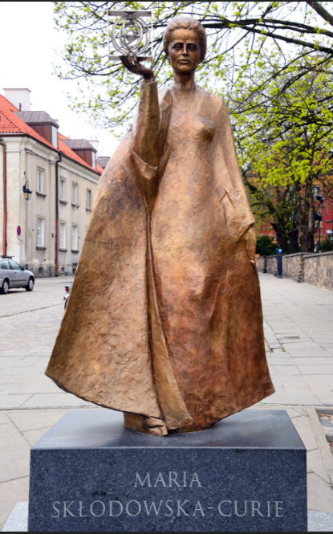
GendeResearchIreland Exploring gender equality in Irish higher education: Qualitative case-study research into the response to, and process of Athena SWAN
Dr. Monica O’Mullane
Marie Skłodowska-Curie Fellow
ISS21
@OMullaneMonica, @ISS21UCC
This project has received funding from the European Union’s Horizon 2020 research and innovation programme under the Marie Skłodowska-Curie grant agreement No.750408.

Slide 2
Today’s presentation
How the MSCA experience has been for me
Getting to a funded MSCA fellowship

Slide 3
Impact of the fellowship on my career development
GendeResearchIreland (http://monicaomullane.com/genderesearchireland/)
Research study exploring the implementation of the Athena SWAN Charter in Irish higher education.
Career Restart (CAR) panel
Part time (over 48 months, 50% time)
Impact of the fellowship on your career development
Research & career development training – achieving professional independence
Publishing and disseminating
Networks & collaborations
Stepping stone

Slide 4
https://www.rte.ie/brainstorm/2021/1104/1257929-all-you-need-to-know-about-marie-curie/

Slide 5
Getting to a funded MSCA fellowship
Moved to Slovakia in 2010- first MSCA application 2011; was hoping to move back to Ireland with MSCA fellowship (with a 2nd attempt)
Scientific coordinator of an EC funded consortium project (GENOVATE) in a Slovak University (2013) (this was where I got the project idea and mentor)

Slide 6
Tips for success for future applicants
Choosing the PI/ mentor
Contact host institution’s research support officers- through your proposed mentor/ PI
Previous applicant’s experience- priceless!! (application & feedback)
Attend all information seminars available (I attended one in Ireland summer before applying)
Circulate drafts to a few selected colleagues
Keep in mind, non-expert reviewers

Slide 7
My MSCA application’s evaluation
Details of the methodology, such as the size of the sample or explaining how the researcher would gain access to the cases and the data are insufficiently described.
The teaching activities planned are only partially described.
Aspects of the communication plan presented are over-ambitious (e.g., creating a YouTube video, 8 workshops at schools, leveraging social media including Twitter, Face Book and a blog) and could become too time consuming.
Although the allocation of tasks and resources is basically sound, limited timing is devoted to the dissemination, communication and public engagement activities, which include many actions but have only a 2.2 person-month planned for them.

