Slide 1



MSCA Postdoctoral Fellowships 2022
Dr Yvonne Halpin,
MSCA National Delegate and National Contact Point
Irish Marie Skłodowska-Curie Office (IMSCO)
26 April 2022

Slide 2

Irish Marie Skłodowska-Curie Office
Supported by the Irish Research Council and operated under a joint partnership with the Irish Universities Association.
Missions:
Promote the MSCA programmes
Contribute to policy initiatives relevant to the Actions
Provide a conception to completion service for the research active community in Ireland
Ireland’s H2020 MSCA drawdown: €197 million
(Total H2020 drawdown: €1.19 billion)

Slide 3

Ireland’s Previous Success
IF in H2020
253
IF Projects Funded
PF 2021 Call
€49.2 M
EU Funding across all proposals with Irish beneficiaries
14.1% IE Success Rate
14.0% Overall Success Rate
15.5% IE Success Rate
14.9% Overall Success Rate

Slide 4
IMSCO Supports for Applicants
Support for applicants across all sectors and disciplines
Promotion of PF call and guidance to applicants
Provision of information webinars and other resources (e.g., handbooks)
Proposal writing workshops
Proposal pre-review service in advance of call deadline

Slide 5





EURAXESS Ireland
EURAXESS is for researchers, universities and entrepreneurs. We provide practical support, operate a website with research jobs and career development opportunities.
EURAXESS links researchers with Beyond Academia sectors
EURAXESS Ireland operates the FastTrack immigration ‘Hosting Agreement’ scheme allowing for employment of non-EEA MSCA fellows in Irish academia and industry
Get in touch by e-mail/phone if you:
Need information about the Hosting Agreement scheme for non-EEA researchers working in Ireland
Have a query concerning employment of a foreign researcher in Ireland on a Hosting Agreement scheme
Have a query related to mobility/employment of researchers with refugee background
Need advice regarding visa or a working permission guidelines
Want to learn about immigration rules in other European countries
Are looking for a job in research
Join the EURAXESS LinkedIn forum ‘Researchers Beyond Academia by EURAXESS’ https://www.linkedin.com/showcase/researchers-beyond-academia-by-euraxess

Slide 6
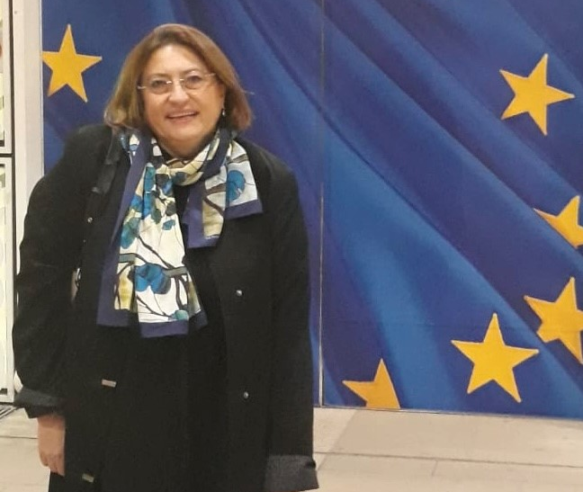
Contact Details for EURAXESS Ireland
EURAXESS Ireland/ National Coordination Point and Service Centre
Irish Universities Association
48 Merrion Square, Dublin 2
Ireland
Contact:
Dr Magda Wislocka
Head of EURAXESS Ireland
Email: magda@iua.ie
Phone: +353 1 6764948
Visit our website: www.euraxess.ie

Slide 7




Thank you!
https://www.iua.ie/for-researchers/marie-sklodowska-curie-actions/funding-calls-and-deadlines/postdoctoral-fellowships/
mariecurie@iua.ie
@Mariescurie_ire
https://www.linkedin.com/groups/4419371

Slide 8
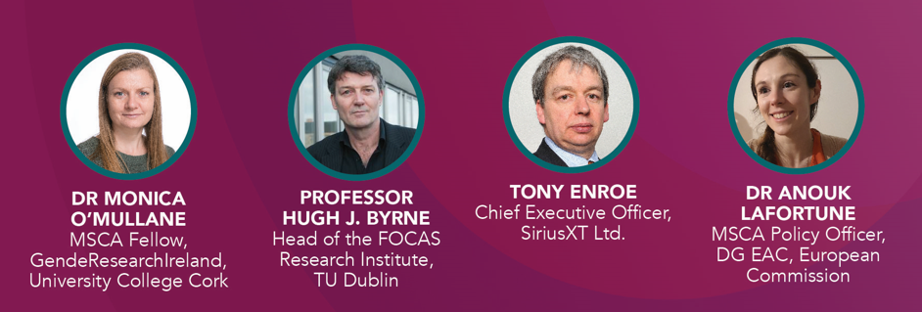
Guest Speakers

