Slide 1



MSCA Staff Exchange 2021
Dr Yvonne Halpin,
MSCA National Delegate and National Contact Point
Irish Marie Skłodowska-Curie Office (IMSCO)
23 November 2021

Slide 2

Irish Marie Skłodowska-Curie Office
Supported by the Irish Research Council and jointly operated under a partnership with the Irish Universities Association.
Missions:
Promote the MSCA programmes
Contribute to policy initiatives relevant to the Actions
Provide a conception to completion service for the research active community in Ireland
Ireland’s H2020 MSCA drawdown: €197 million
(Total H2020 drawdown: €1.18 billion)

Slide 3

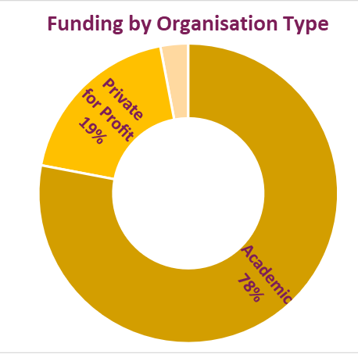


Ireland’s RISE Success in H2020
27
RISE Projects Coordinated
x 1.8
IE vs EU Average Success Rate
MSCA RISE
H2020 (IE)
€12.5 M
EU Funding across all proposals with Irish beneficiaries

Slide 4
IMSCO Supports for Applicants
Support for applicants across all sectors and disciplines
Promotion of Staff Exchange and guidance to applicants
Provision of information webinars and other resources
Proposal pre-review service in advance of call deadline

Slide 5





EURAXESS Ireland
EURAXESS is for researchers, universities and entrepreneurs. Our mission is to provide practical support and links to research job and career development opportunities.
EURAXESS Ireland operates the FastTrack immigration ‘Hosting Agreement’ scheme allowing for employment of non-EEA MSCA fellows in Irish academia and industry
Contact us if you:
Need information about the Hosting Agreement scheme for non-EEA researchers working in Ireland
Have a query concerning employment of a foreign researcher in Ireland on a Hosting Agreement scheme
Need advice regarding visa or a working permission guidelines
Want to learn about immigration rules in other European countries
Need to contact a EURAXESS expert in another country
Are looking for a job in research
Want to engage in any of the EURAXESS initiatives such as the recent ‘Intersectoral mentoring program
for early-stage researchers 2022’
Need to contact Irish EURAXESS directly with another query

Slide 6
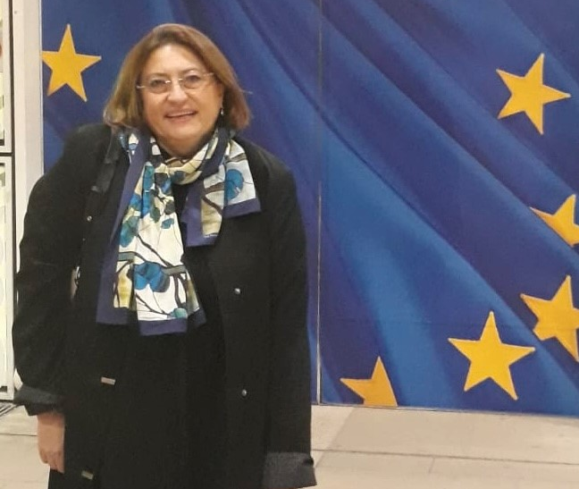
Contact Details for EURAXESS Ireland
EURAXESS Ireland/ National Coordination Point and Service Centre
Irish Universities Association
48 Merrion Square, Dublin 2
Ireland
Contact:
Dr Magda Wislocka
Head of EURAXESS Ireland
Email: magda@iua.ie
Phone: +353 1 6764948
Visit our website: www.euraxess.ie

Slide 7




Thank you!
https://www.iua.ie/for-researchers/marie-sklodowska-curie-actions/funding-calls-and-deadlines/staff-exchange/
mariecurie@iua.ie
@Mariescurie_ire
https://www.linkedin.com/groups/4419371

Slide 8
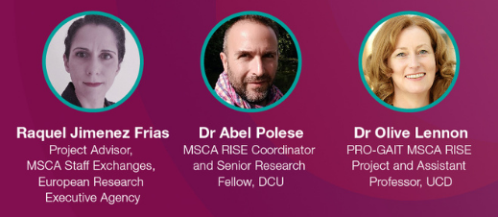
Guest Speakers

